Slide 1

Digital Electronic Circuits
Dr. Samer Arandi
© Dr. Samer Arandi - An-Najah National University

Slide 2
Course Outline
Bipolar Families: RTL,DTL, TTL,ECL and I²L
NMOS Transistor Analysis
CMOS Inverters and gates
CMOS Fabrication
OP-AMPs
Sensors and Transducers (optical and ultrasonic)
Driver Circuits (motors, relays, Triacs, Diacs)
Digital to Analogue and Analogue to Digital
Regulated Power Supplies
© Dr. Samer Arandi - An-Najah National University

Slide 3
Introduction
Integrated Circuits (IC): arbitrary number of interconnected gates in a silicon semiconductor crystal (chip)
Contains electronic components for constructing digital gates
Mounted in a ceramic or plastic container that exposes a number of pins (tens to thousands)
Complexity is measured by the number of logic gates in a single chip
© Dr. Samer Arandi - An-Najah National University

Slide 4
Levels of Integration
Small scale Integration (SSI): typically fewer than 10 independent gates – early 60s
Medium Scale Integration (MSI): 10 to 1000 of gates (decoders, adders, multiplexers) – late 60s
Large Scale Integration (LSI): thousands of gates (1st and 2nd generation processors, memory chips, PLD) – mid 70s
Very Large Scale Integration (VLSI/ULSI): hundreds of thousands of gates to several billions (complex microcomputers chips) – 80s till present
System-on-a-Chip (SoC): all components needed by a computer is included on a single chip.
– Lower manufacturing cost and reduced power budget. Why?
3 Dimensional Integrated Circuits (3D-ICs): two or more layers of components integrated both vertically and horizontally. Reduced power budget and overall wire length
© Dr. Samer Arandi - An-Najah National University

Slide 5
Digital Logic Families
The basic circuit in each technology/family is a NAND, NOR or INVERTER.
Many families have been introduced:
Bipolar Transistors (flow of two carriers)
RTL: Resistor-Transistor Logic
DTL: Diode-Transistor Logic
TTL: Transistor-Transistor Logic
ECL: Emitter-Coupled Logic
I²L: Integrated Injection Logic
Unipolar Transistors (Field Effect Transistors)
MOS: Metal-Oxide Semiconductor – high density
CMOS: Complementary MOS – lower power consumption, dominant family, used in VLSI
© Dr. Samer Arandi - An-Najah National University

Slide 6
Logic Family Characterization
Fan-Out
Power Dissipation
Propagation Delay
Noise Margin
© Dr. Samer Arandi - An-Najah National University

Slide 7
The Standard TTL series Characteristics
1964 TI introduced first line of standard TTL IC’s.
54/74 series
one of the most widely used series
known as the 74 series (54 wider temperature range)
Many semiconductor IC manufactures produce TTL IC’s
Fortunately all use the same numbering system allowing interchanging of components
SN74 DM74 S74
Texas Instruments 74 Series National Semiconductor 74 Series Signetics 74 Series
© Dr. Samer Arandi - An-Najah National University

Slide 8
The Standard TTL series Characteristics
Several other TTL series have been developed since the introduction of the 74 standard series.
74LS, 74S etc.
Provide a wide choice of speed and power characteristics
Speed Power (picoJoules): the lower the better
Differences in TTL family are not in Logic Levels, but in internal construction of the basic NAND gate.
© Dr. Samer Arandi - An-Najah National University

Slide 9
The Standard TTL series Characteristics
The propagation delay of a transistor which goes into saturation depends on two factors:
Saturation delay (storage time delay)
RC time constant
By reducing resistor values
reduces RC time constant
decreases propagation delay
Trade-off is high power dissipation
lower resistance draws more current from power supply
© Dr. Samer Arandi - An-Najah National University

Slide 10
Low Power, 74L series
Similar to a standard TTL
But all resistor values have been increased.
⇒ | low power dissipation | 1 mW
⇒ | greater propagation delay | 33 nseconds
good for applications with low frequency, battery operated circuits
– calculators etc.
© Dr. Samer Arandi - An-Najah National University

Slide 11
High Speed, 74H series
Similar to a standard TTL
But all resistor values have been reduced.
⇒ faster switching ⇒ propagation delay 6 nseconds but
⇒ increased power dissipation 22 mW
© Dr. Samer Arandi - An-Najah National University

Slide 12
How to increase speed ?
Whatever is done to the value of the resistors
Speed is ultimately limited by the time required to pull the output transistors out of saturation.
74, 74L and 74H series all operate with saturated switching
many of the transistors, when conducting will be in a saturated condition
As has been seen this causes a saturation delay (storage delay), when switching from ON to OFF
limits the circuit’s switching speed.
© Dr. Samer Arandi - An-Najah National University

Slide 13

Schottky TTL, 74S series
Can this be improved ?
In Schottky TTL (STTL)
Transistors kept out of saturation by using Schottky barrier
diodes (SD)
Formed by a junction of a metal and semiconductor
conventional diode with a junction of p-type and n-type
semiconductor material
SD connected between the base and the collector
Do not allow the transistors to go
as deeply into saturation
SD has a forward voltage
drop of 0.4V
=
© Dr. Samer Arandi - An-Najah National University

Slide 14
Schottky TTL, 74S series
When the Collector-Base junction becomes forward biased at the on-set of saturation
⇒ SD will conduct, diverting some input current away from base.
⇒ this has effect of reducing the excess base current.
⇒ decreases saturation (storage time) delay at turn-off
74S00 NAND has average propagation delay of 3 nsecs
twice as fast as the 74H00
makes the 74H series redundant nowadays
© Dr. Samer Arandi - An-Najah National University

Slide 15
Schottky TTL, 74S series
Circuit also uses smaller resistor values to improve switching times
Improves the circuit average power dissipation to
20 mW
NOTE
All transistor are Schottky Transistors.
Q4 is not required to be a Schottky, why?
© Dr. Samer Arandi - An-Najah National University

Slide 16



Schottky TTL, 74S series
+5 V
55Ω
2.8kΩ
760Ω
Q3
Q
Q₄
A
B C
1
Q
3.5kΩ
2
Output
Q₅
370Ω
350Ω
Q₆
© Dr. Samer Arandi - An-Najah National University

Slide 17
Low Power Schottky TTL, 74LS series
74 LS is a low powered version of the 74S series
uses with larger resistor values than 74S
Low circuit power requirements
but at the expense of increase in switching times.
Power Dissipation
Propagation Delay
2 mW
9.5 nseconds
This is the mainstay of the TTL family
Found in nearly all new designs that do not require max speed.
© Dr. Samer Arandi - An-Najah National University

Slide 18
Advanced Schottky TTL, 74AS series
As a result of the recent development in IC design and manufacturing process
– High speed Schottky diodes
Power Dissipation
Propagation Delay
10 mW
1.5 nseconds
© Dr. Samer Arandi - An-Najah National University

Slide 19
Improvement in both power and speed.
Advanced Low-Power Schottky TTL, 74ALS series
Power Dissipation
Propagation Delay
1 mW
4 nseconds
This series has
the lowest speed-power product of the TTL series
very close to the lowest gate power dissipation
This will eventually replace 74LS as the most widely used TTL series.
© Dr. Samer Arandi - An-Najah National University

Slide 20
Emitter Coupled Logic
© Dr. Samer Arandi - An-Najah National University

Slide 21
Emitter Coupled Logic (ECL)
Non-saturated digital logic family
Since transistors do not saturate, it is possible to achieve a prop. delay of 1-2 ns (fastest family)
Utilized in systems that require very high speed
Power dissipation and noise immunity is the worst!
Power dissipation 25 mw
© Dr. Samer Arandi - An-Najah National University

Slide 22
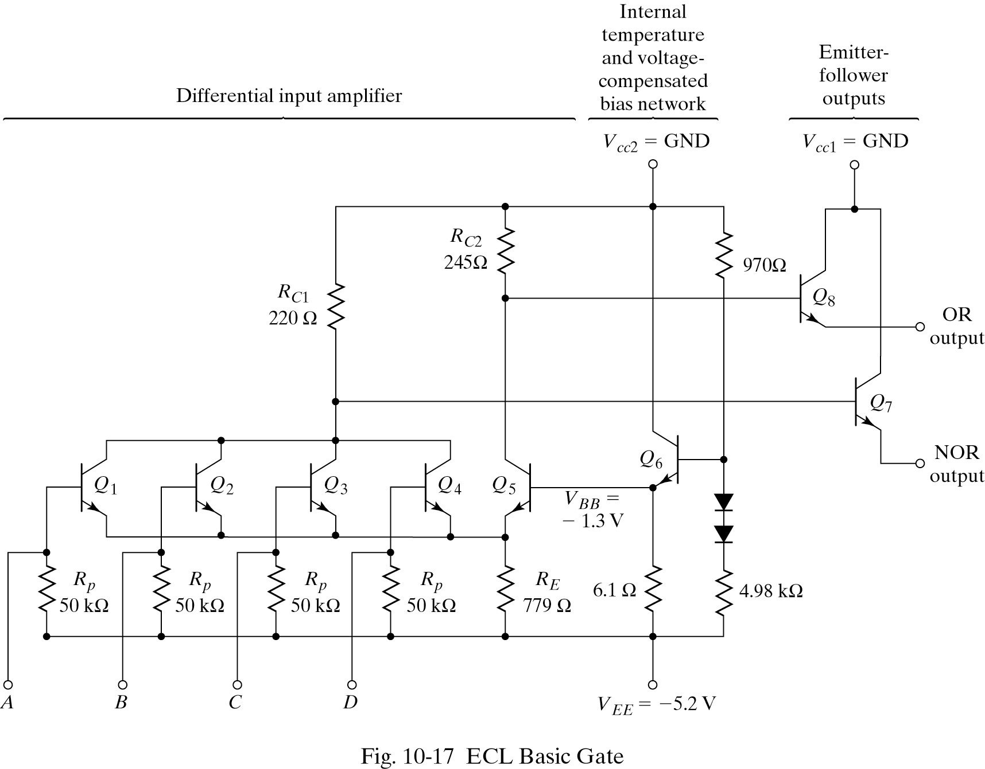
Emitter Coupled Logic (ECL)
© Dr. Samer Arandi - An-Najah National University

Slide 23
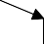


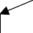
ECL - Simplified
Differential Input amplifier
Emitter Follower Output
-0.8 V High
-1.8 V Low
GND
GND
245 Ω
Q8
220 Ω
OR
Q7
NOR
Q1
Q2
Q5
VBB=-1.3V
VBB: bias voltage, mid-point of the logic swing
779 Ω
50 KΩ
50 KΩ
Use of VCC as ground and VEE at -5.2 V
results in best noise immunity
A
B
VEE=-5.2 V
© Dr. Samer Arandi - An-Najah National University

Slide 24

ECL - Simplified
-0.8 V High
-1.8 V Low
GND
GND
245 Ω
Q8
220 Ω
OR
Q7
NOR
Q1
Q2
Q5
VBB=-1.3V
779 Ω
50 KΩ
50 KΩ
A
B
VEE=-5.2 V
© Dr. Samer Arandi - An-Najah National University

Slide 25
ECL - Simplified
-0.8 V High
-1.8 V Low
GND
GND
245 Ω
Q8
220 Ω
OR
Q7
NOR
Q1
Q2
Q5
VBB=-1.3V
779 Ω
50 KΩ
50 KΩ
A = High (-0.8)
B
VEE=-5.2 V
© Dr. Samer Arandi - An-Najah National University

Slide 26
ECL - Simplified
-0.8 V High
-1.8 V Low
GND
GND
245 Ω
Q8
220 Ω
OR
Q7
ON
NOR
Q1
Q2
Q5
VBB=-1.3V
-1.6 V
779 Ω
50 KΩ
50 KΩ
A = High (-0.8)
B
VEE=-5.2 V
© Dr. Samer Arandi - An-Najah National University

Slide 27
ECL - Simplified
-0.8 V High
-1.8 V Low
GND
GND
245 Ω
Q8
220 Ω
OR
Q7
NOR
Q1
Q2
Q5
VBB=-1.3V
-1.6 V
Difference between VBB & VE is 0.3 V only Q5 is cut-off
779 Ω
50 KΩ
50 KΩ
A = High (-0.8)
B
VEE=-5.2 V
© Dr. Samer Arandi - An-Najah National University

Slide 28
ECL - Simplified
-0.8 V High
-1.8 V Low
GND
GND
245 Ω
Q8
OR
-0.8 V
220 Ω
Q7
NOR
Q1
Q2
Q5
VBB=-1.3V
-1.6 V
Difference between VBB & VE is 0.3 V only Q5 is cut-off
779 Ω
50 KΩ
50 KΩ
A = High (-0.8)
B
VEE=-5.2 V
© Dr. Samer Arandi - An-Najah National University

Slide 29
ECL - Simplified
-0.8 V High
-1.8 V Low
GND
GND
245 Ω
Q8
(-1.6 - -5.2)*220/779
-0.8 V
1.0 V
220 Ω
OR
Q7
NOR -1.8 V
Q1
Q2
Q5
VBB=-1.3V
-1.6 V
Difference between VBB & VE is 0.3 V only Q5 is cut-off
779 Ω
50 KΩ
50 KΩ
A = High (-0.8)
B
VEE=-5.2 V
© Dr. Samer Arandi - An-Najah National University

Slide 30
ECL - Simplified
-0.8 V High
-1.8 V Low
GND
GND
245 Ω
Q8
220 Ω
OR
Q7
NOR
Q1
Q2
Q5
VBB=-1.3V
779 Ω
50 KΩ
50 KΩ
A
B
VEE=-5.2 V
© Dr. Samer Arandi - An-Najah National University

Slide 31
ECL - Simplified
-0.8 V High
-1.8 V Low
GND
GND
245 Ω
Q8
220 Ω
OR
Q7
NOR
Q1
Q2
Q5
VBB=-1.3V
779 Ω
50 KΩ
50 KΩ
A
B
VEE=-5.2 V
= Low (-1.8) = Low (-1.8)
© Dr. Samer Arandi - An-Najah National University

Slide 32
ECL - Simplified
-0.8 V High
-1.8 V Low
GND
GND
245 Ω
Q8
220 Ω
OR
Q7
cut-off
cut-off
NOR
Q1
Q2
Q5
VBB=-1.3V
-2.1 V
779 Ω
50 KΩ
50 KΩ
A
B
VEE=-5.2 V
= Low (-1.8) = Low (-1.8)
© Dr. Samer Arandi - An-Najah National University

Slide 33
ECL - Simplified
-0.8 V High
-1.8 V Low
GND
(-2.1 - -5.2) * 245 / 779
GND
1.0 V
245 Ω
Q8
OR
-1.8 V
220 Ω
Q7
cut-off
cut-off
NOR
Q1
Q2
Q5
VBB=-1.3V
-2.1 V
779 Ω
50 KΩ
50 KΩ
A
B
VEE=-5.2 V
= Low (-1.8) = Low (-1.8)
© Dr. Samer Arandi - An-Najah National University

Slide 34
ECL - Simplified
-0.8 V High
-1.8 V Low
GND
GND
1.0 V
245 Ω
Q8
OR
-1.8 V
220 Ω
Q7
cut-off
cut-off
Q1
NOR -0.8 V
Q2
Q5
VBB=-1.3V
-2.1 V
779 Ω
50 KΩ
50 KΩ
A
B
VEE=-5.2 V
= Low (-1.8) = Low (-1.8)
© Dr. Samer Arandi - An-Najah National University

Slide 35
Integrated Injection Logic
© Dr. Samer Arandi - An-Najah National University

Slide 36
Integrated Injection Logic (I²L)
Saturated bipolar logic family
Utilized in MSI and LSI
Small size
Low power consumption
Cheaper fabrication cost
Merges transistor components - Merged Transistor Logic (MTL)
One semi-conductor region is part of two or more devices.
This allows considerable saving in silicon chip area.
© Dr. Samer Arandi - An-Najah National University

Slide 37
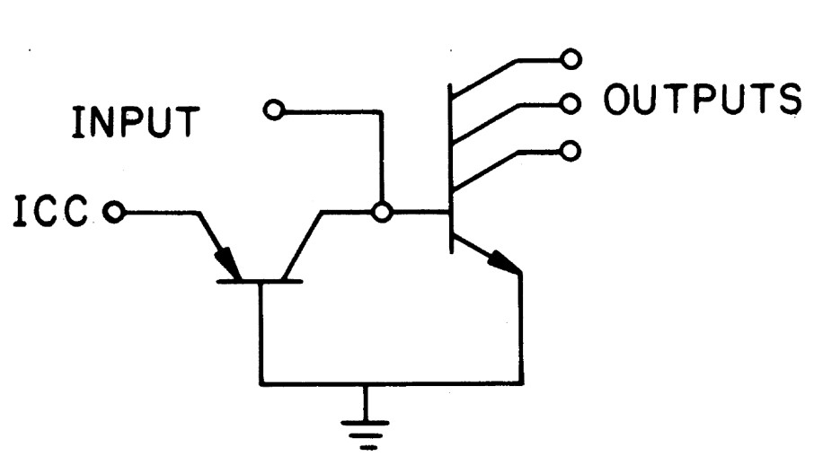
Integrated Injection Logic (I²L)
A single inverter is implemented as:
Multi-collector npn transistor
Multi-collector pnp transistor that is driving the npn transistor.
The emitter of the driving transistor is called the injector
© Dr. Samer Arandi - An-Najah National University

Slide 38
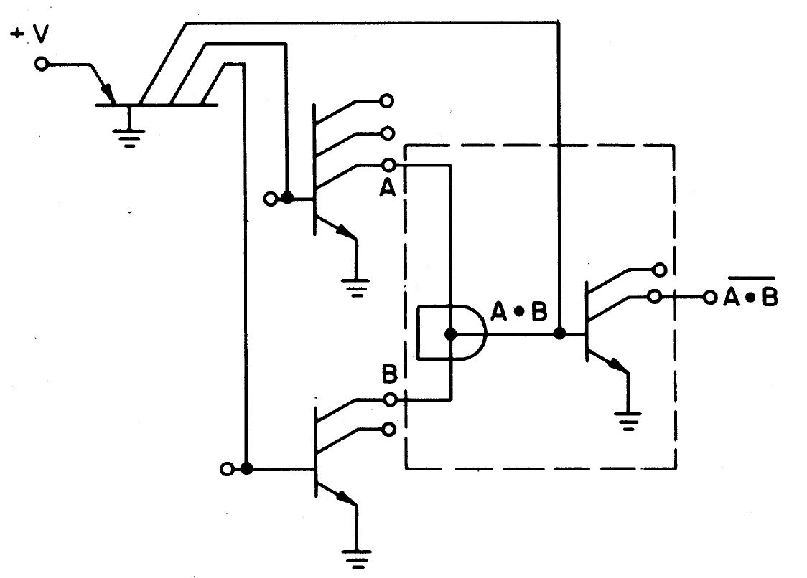
Integrated Injection Logic (I²L)
The injector distributes current to multiple units which form its multi-collectors.
Open-collector output which allows a wired-and configuration (typically followed by an inverter)
© Dr. Samer Arandi - An-Najah National University

Slide 39
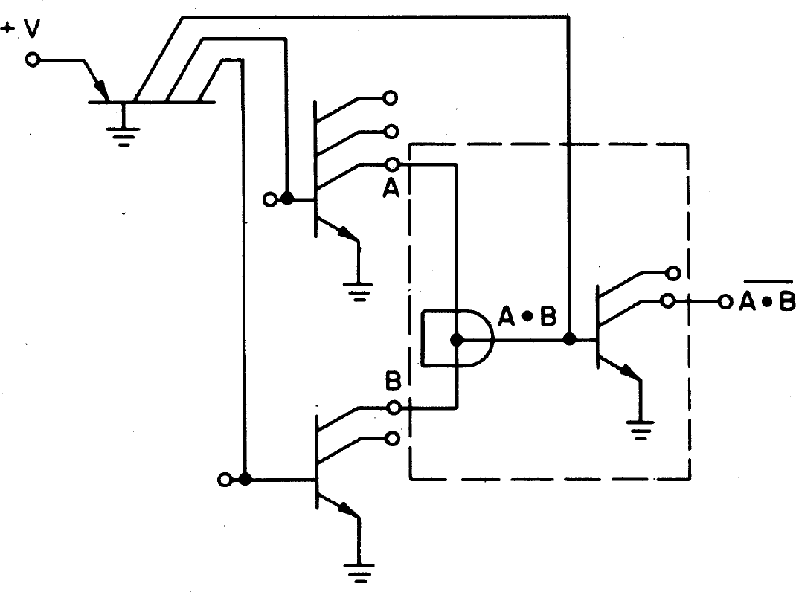
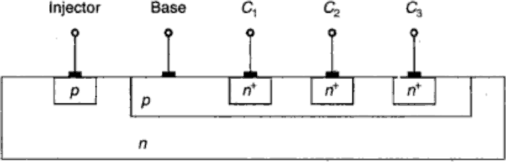
Integrated Injection Logic (I²L)
The collector of the current injector transistor and the base of each multiple collector transistor are merged, i.e. one p region is used for both
The base of the injector transistor is merged with the emitter of the multiple collector transistor.
© Dr. Samer Arandi - An-Najah National University

Slide 40
Metal Oxide Semiconductor
© Dr. Samer Arandi - An-Najah National University

Slide 41
Metal Oxide Semiconductor
Field Effect Transistor (FET): unipolar transistor as its operation depends on the flow of one type of carriers
Two types of FETs:
Junction Field Effect Transistor (JFET) – used mainly in linear circuits
Metal-Oxide Semi-conductor FET (MOSFET) – used in digital circuits
Advantage: fabricated in less area than Bipolar
Transistors
© Dr. Samer Arandi - An-Najah National University

Slide 42
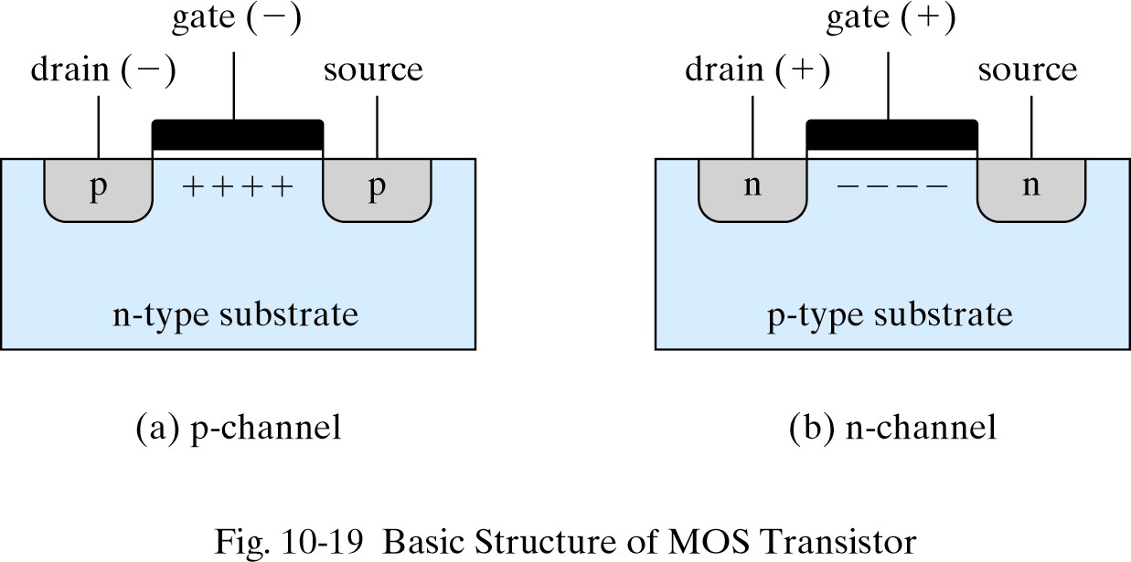
MOS Transistors
p-channel
n-type substrate (lightly doped)
Two heavily doped regions with p-type impurities (source and drain)
The region between the source and drain is called the channel
The gate is the metal plate separated from the substrate by an insulated dielectric of silicon dioxide
A negative voltage at the gate => induced electric field at the channel => attracts p-type carriers (holes) => conductivity increases => current flows from source to drain
© Dr. Samer Arandi - An-Najah National University

Slide 43
MOS Transistors
Two modes of operation (depends on the state of the channel at zero voltage):
– Depletion
channel is initially doped with p-type impurities,
i.e. a conducting channel exists at 0 V
Enhancement
region beneath the gate is initially uncharged
a voltage must be applied to the gate to induced a
channel i.e. current is enhanced by gate voltage
© Dr. Samer Arandi - An-Najah National University

Slide 44
MOS Transistors
The majority carriers enter the device from the source terminal to the drain when the voltage applied to the gate exceeds a threshold VT
p-channel
The source is connected to the substrate and a negative voltage
is applied to the drain
When the gate voltage is sufficiently negative below VT p-type
carriers flow from S to D (positive current flow)
n-channel
The source is connected to the substrate and a positive voltage
is applied to the drain
When the gate voltage is sufficiently positive above VT n-type carriers flow from S to D (equivalent to positive current flow from D to S)
© Dr. Samer Arandi - An-Najah National University

Slide 45
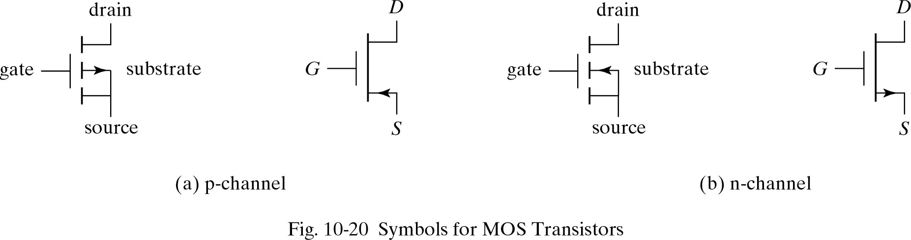
MOS Transistors
Symbols for MOS Transistors
Enhancement Mode
© Dr. Samer Arandi - An-Najah National University

Slide 46
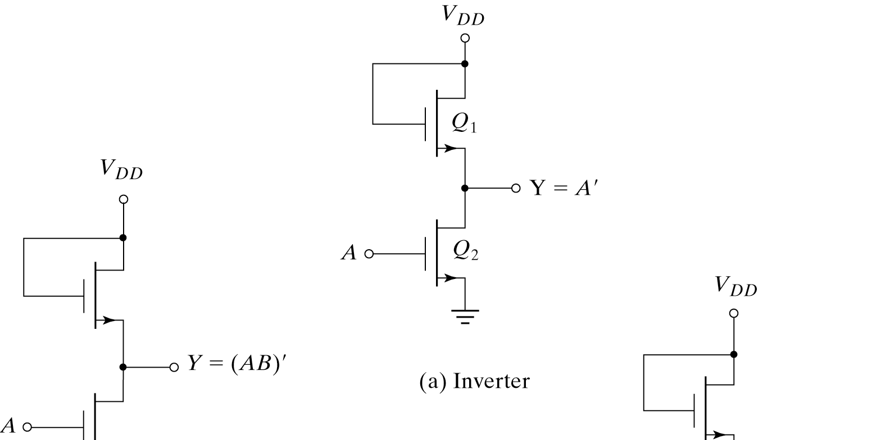
MOS – Logic Gates
MOSFET can be used as resistor as well as a transistor
Resistance value can be determined as the ratio between VDS and IDS Different resistor values may be constructed during manufacturing by fixing the channel length and width of the MOS device
RQ1: Load Resistor RQ2<<RQ1
© Dr. Samer Arandi - An-Najah National University

Slide 47
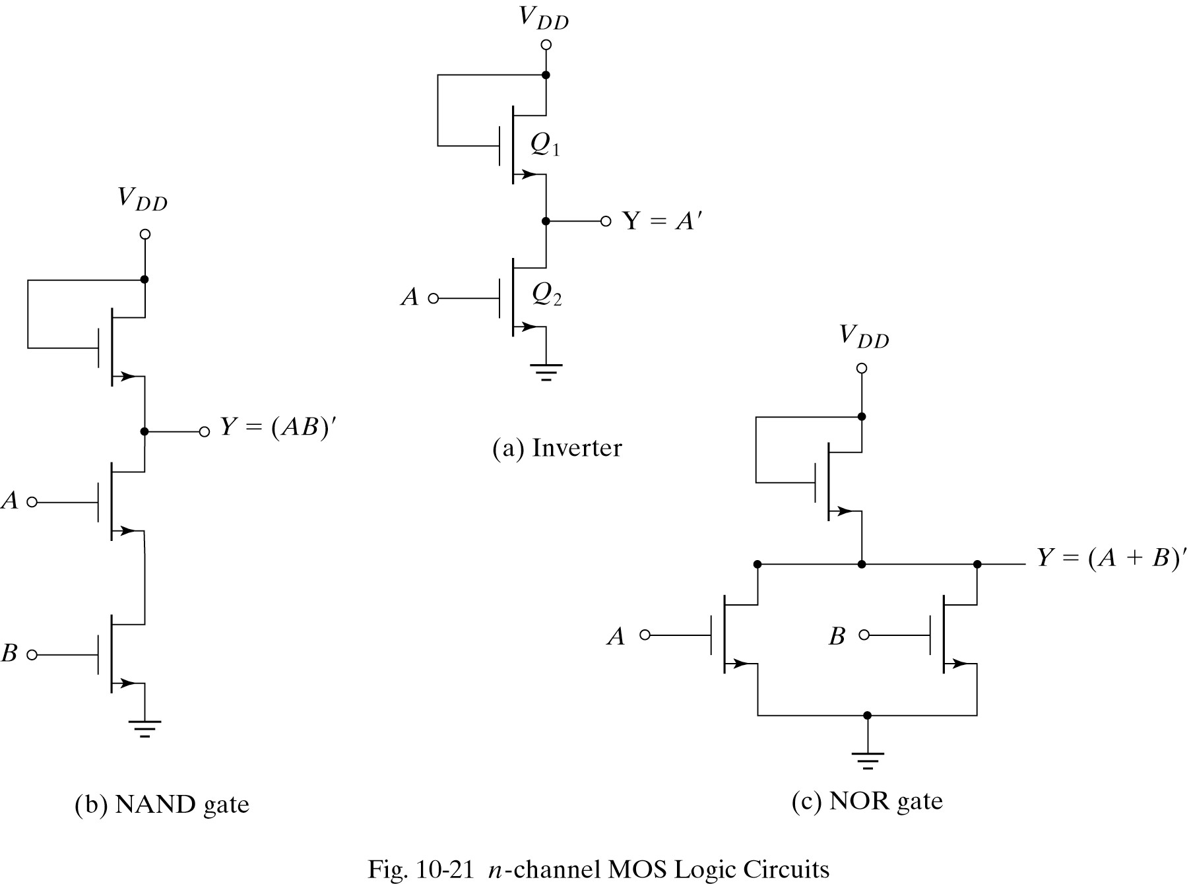
MOS – Logic Gates
RQ2+RQ3<<RQ1
Q1
Q2
Q3
© Dr. Samer Arandi - An-Najah National University

Slide 48
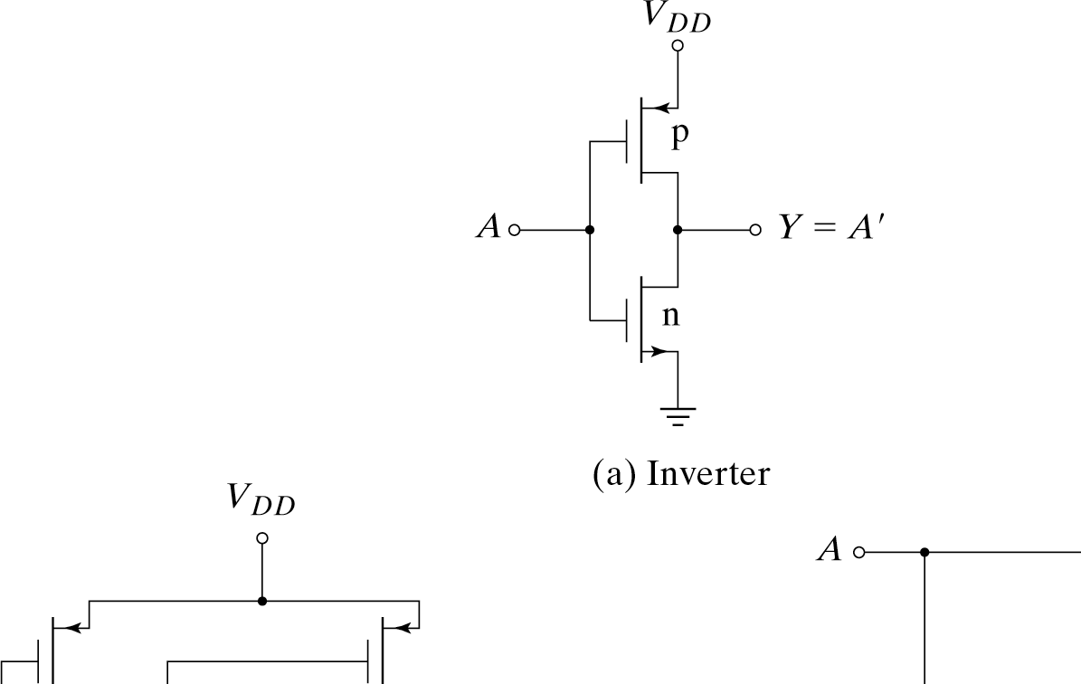
Complementary MOS
Takes advantage of the ability to fabricate both n-type and p-type on the same substrate
Basic circuit is the inverter:
– The n-MOS conducts when gate-to-source is pos+
The p-MOS conducts when gate-to-source is neg-
Both are turned off when
s
d d
s
gate-to-source is zero
© Dr. Samer Arandi - An-Najah National
U
niversity

Slide 49
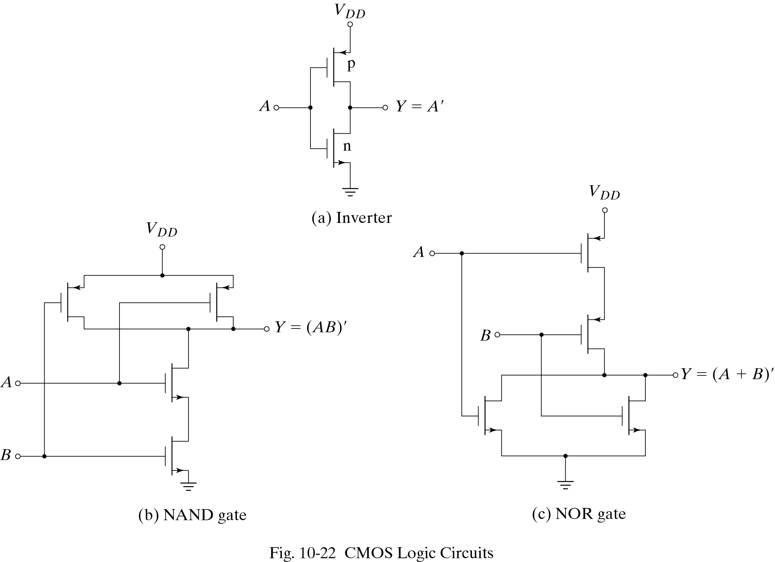
CMOS – Logic Gates
© Dr. Samer Arandi - An-Najah National University

Slide 50
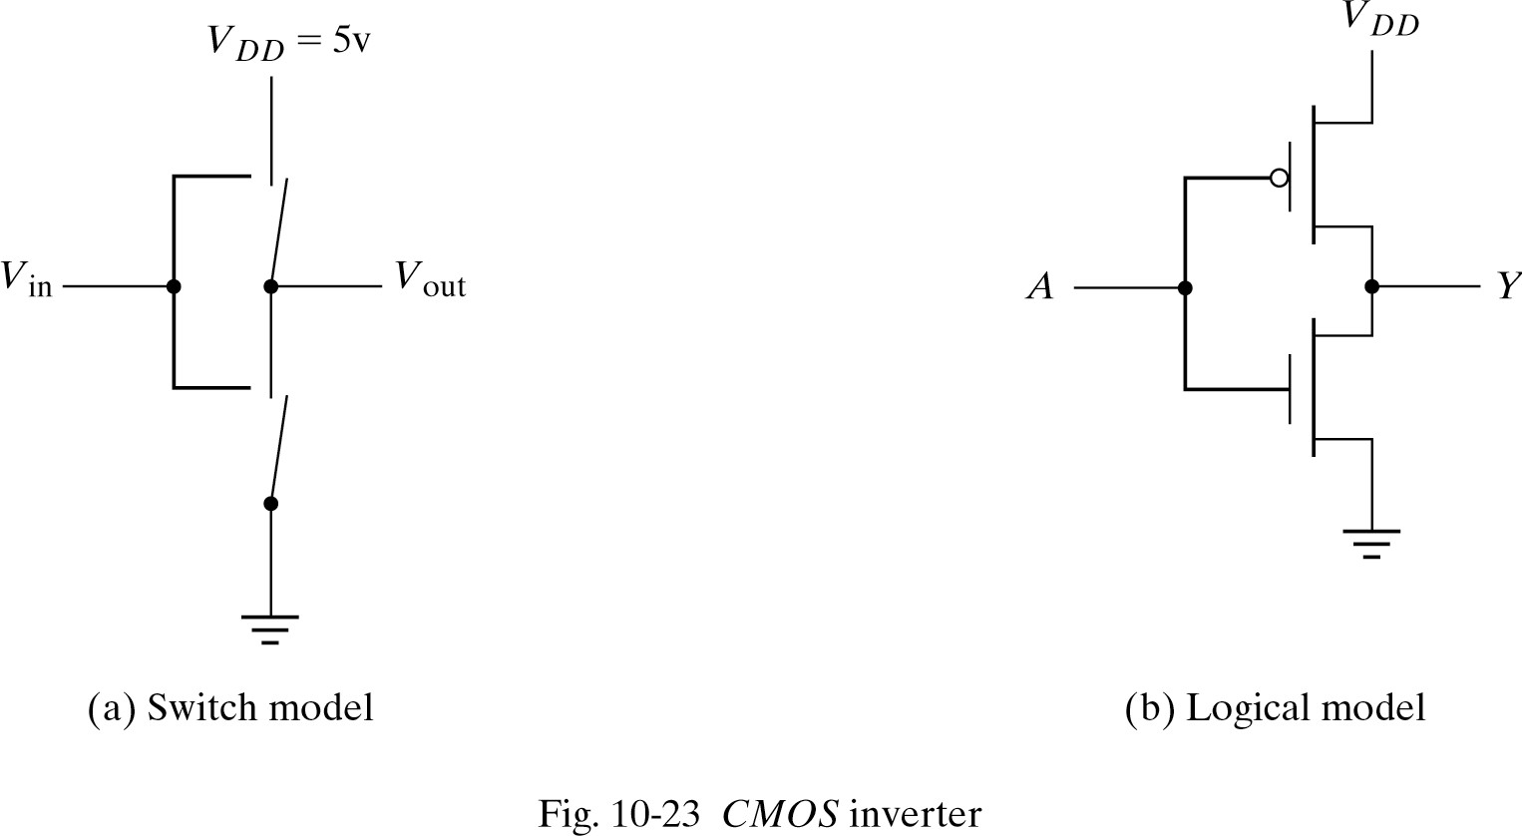
CMOS – Models/Symbols
© Dr. Samer Arandi - An-Najah National University

Slide 51
MOS Operation and Analysis
© Dr. Samer Arandi - An-Najah National University

Slide 52
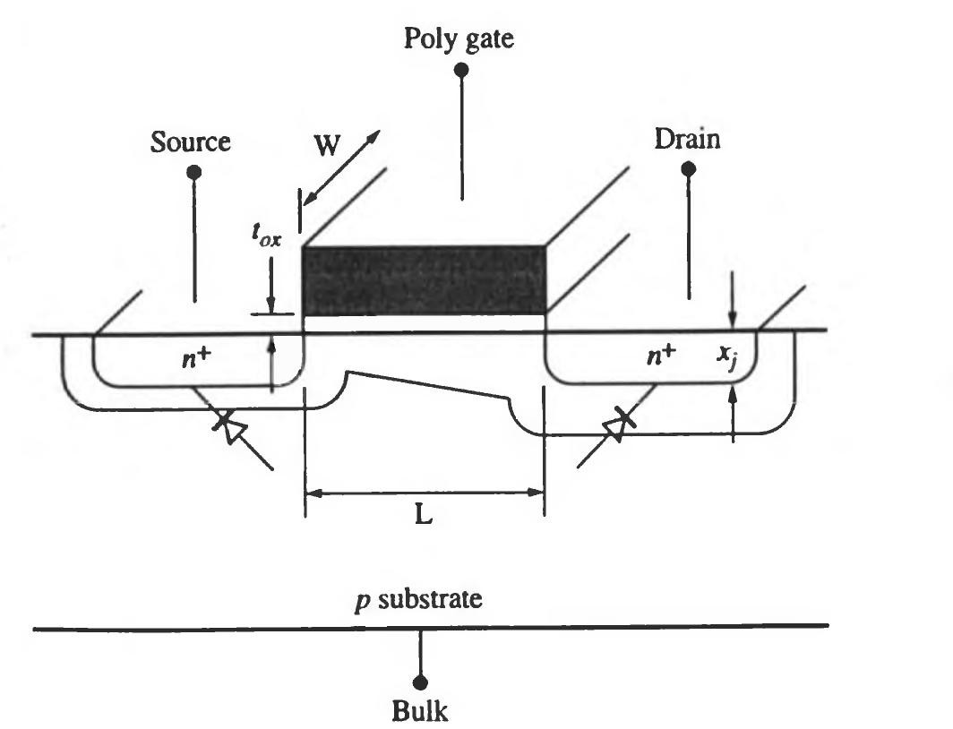
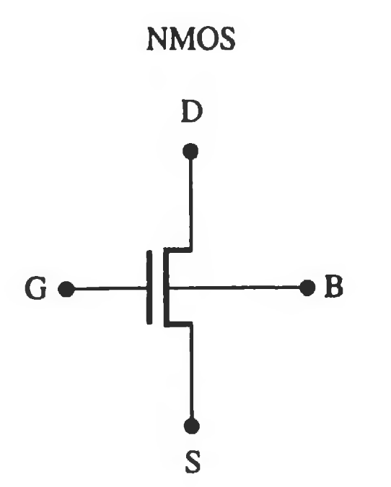
L: channel length (350nm – 90nm ~ 2004)
W: channel width
t_{ox}: gate oxide thickness (< 25 Å ~2004)
bulk(substrate): doping density
x_{j}: junction depth (150 – 70 nm ~2004)
Determine the electrical Characteristics of
the transistor
© Dr. Samer Arandi - An-Najah National University

Slide 53
MOS Threshold Voltage
Threshold Voltage (V_{T}): the minimum gate voltage needed to
initiate the forming of a conducting channel
VT mainly depends on the material properties - largely
determined at the time of fabrication
The most important factors affecting VT include:
The gate conductor material (poly vs. metal)
The gate insulation material (SiO₂)
Impurities in the oxide
The thickness of the gate material
The channel doping concentration
VT is also depends on:
Temperature: changes by -2mV/degree C for low substrate doping levels
Source-Bulk voltage V_{SB}
© Dr. Samer Arandi - An-Najah National University

Slide 54
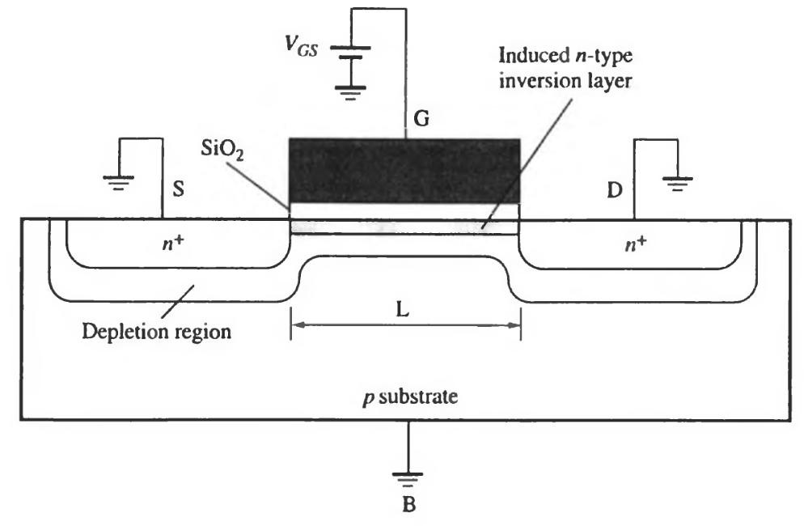
As VGS moves from 0 to a positive value:
positive charge accumulates on the gate
negative charge (electrons) accumulates in the substrate under the gate
The mobile holes are pushed down creating a depletion layer (contains the immobile negative charge)
As the voltage increases the depletion layer thickness increases and a layer of mobile electrons appear
(weak inversion condition)
Further increase in the voltage increases the concentration
of the electrons until its equal to the concentration of the holes
(strong inversion condition)
© Dr. Samer Arandi - An-Najah National University

Slide 55
For gate voltage above this point:
The depletion layer thickness remains approximately constant
Additional mobile carriers accumulate in the channel (drawn from S & D)
Application of V_{DS} > 0 causes current to flow in the channel
The value of the V_{GS} required to produce strong inversion is called
the threshold voltage
© Dr. Samer Arandi - An-Najah National University

Slide 56
Threshold Voltage Components
V_{T} has three main components:
Φ_{GC}: difference in work function between the gate material (G) and the silicon substrate on the channel side (C)
undesirable positive charge Q_{ox} due to imperfections in the semi-oxide interface doping
voltage required to change the surface potential to the strong inversion condition and to offset the induced depletion layer charge Q_{B}
V_{T} = Φ_{GC} – Q_{ox}/C_{ox} – 2Φ_{F} – Q_{B}/C_{ox}
At VSB = 0, VT and QB are denoted as VT0 and QB0
© Dr. Samer Arandi - An-Najah National University

Slide 57
V_{T0} = Φ_{GC} – Q_{ox}/C_{ox} – 2Φ_{F}
– Q_{B0}/C_{ox}
^{V}FB
k *t _{ln} ni q NA
Φ =
F
V_{FB} : flat band voltage
Φ_{F} : equilibrium electrostatic potential
(the shift in Fermi level due to doping)
Thermal voltage
= 26mV
|2Φ_{F}| : band bending voltage
: intrinsic (non-doped carrier concentration)
depends on temperature (1.45x10¹⁰ cm⁻³)
N_{A} : carriers density in doped semi-conductor
for p-type material (N_{D} for n-type)
: Boltzman constant, T: temperature, q: electron charge
ni
K
© Dr. Samer Arandi - An-Najah National University

Slide 58
2*εSi* | −2ΦF |
Q
= q * NA * Xd
X_{d} =
B0
q * NA
εox
Q_{B0} =
− 2q *εSi * NA* | −2ΦF|
C =
ox
tox
q : electronic charge (1.6x10⁻¹⁹)
X_{d} : depletion layer width
ε_{Si} : permittivity of silicon (1.06x10⁻¹²)
for p-type material (N_{D} for n-type)
: Source-Bulk voltage (typically zero)
^{V}SB
^{C}ox ^{ε}ox ^{t}ox
: gate-oxide capacitance
: permittivity of oxide
: oxide thickness
© Dr. Samer Arandi - An-Najah National University

Slide 59
Signs
V_{FB} is negative in nMOS, positive in pMOS
Φ_{F} is negative in nMOS, positive in pMOS
Q_{B0} and Q_{B} are negative in nNMOS, positive in pMOS
V_{SB} is positive in nMOS, negative in pMOS
© Dr. Samer Arandi - An-Najah National University

Slide 60
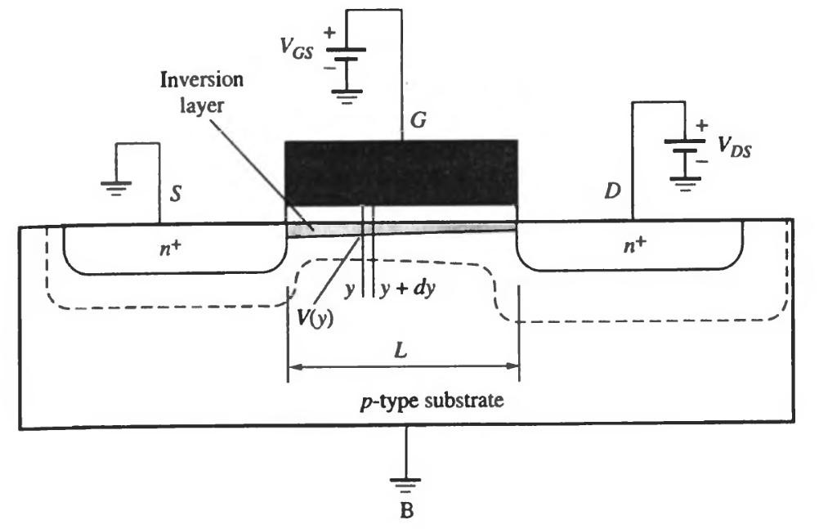
Current-Voltage Characteristics
MOS has three modes of operation:
Cut-off
Linear
Saturation
V_{GS} < V_{T} (I_{DS} is zero)
V_{GS} > V
T, ^{V}DS^{>0 (I}DS
is non-zero)
The mode depends on the terminal voltages:
V_{GS}
V_{DS}
© Dr. Samer Arandi - An-Najah National University

Slide 61
Linear Mode
At VDS = 0, the inverted channel is in equilibrium and IDS = 0
If a small VDS > 0 is applied, IDS will flow from S to D, such that IDS is proportional to VDS
The transistor
(the channel) acts as a voltage controlled resistor
© Dr. Samer Arandi - An-Najah National University

Slide 62
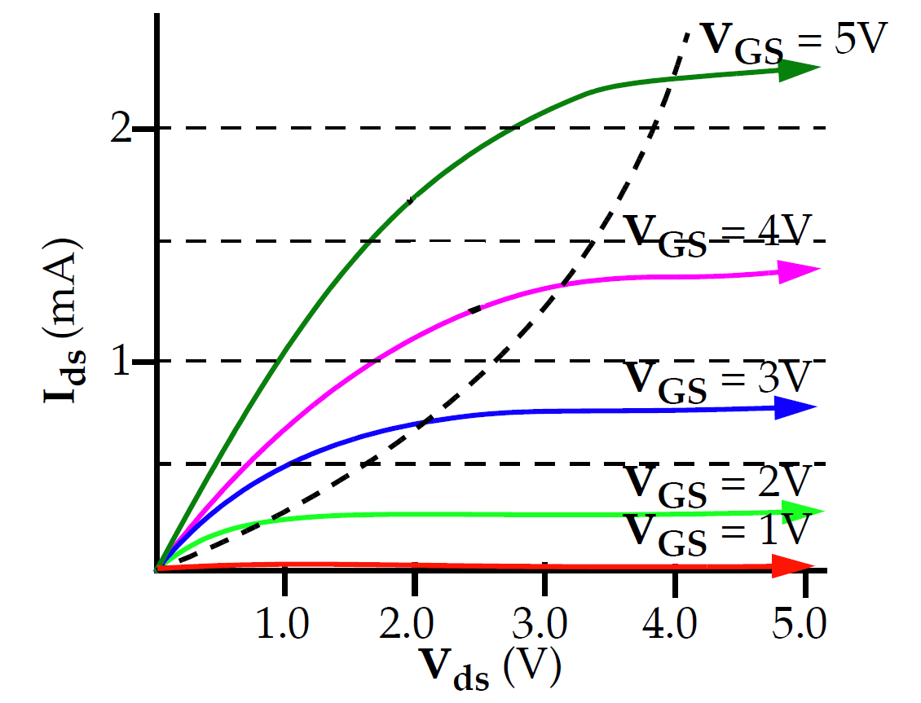
Linear Mode
K
IDS =
[2(V
2
GS −VT )VDS −VDS ]
2
K = K'^{W}
L
K ' = μn *Cox = ^{μnεox}
tox
µn : carrier mobility
IDS depends on both VGS and VDS
© Dr. Samer Arandi - An-Najah National University

Slide 63
Saturation Mode
As the drain voltage is increased the inversion layer charge and the channel depth at the drain decreases
At VDS = VGS-VT0 (called VDSAT) the channel inversion charge at the drain becomes zero (pinch-off point)
As VDS > VDSAT the inversion layer near the drain vanishes -> channel length decreases
© Dr. Samer Arandi - An-Najah National University

Slide 64
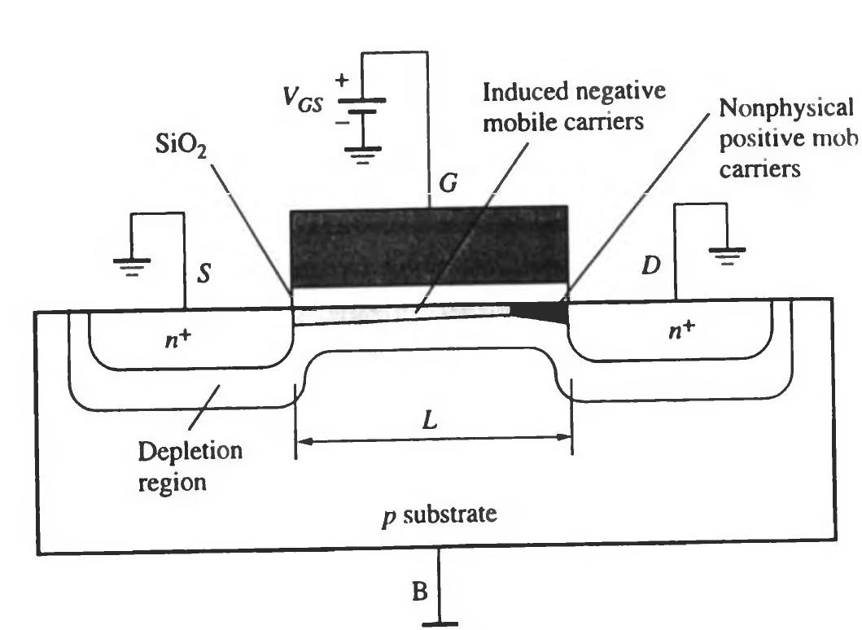
Saturation Mode
IDS = ^{K} (VGS −VT )²
2
IDS = ^{K} (VGS −VT )²(1+ λ *VDS )
Pinch-off point
2
(account for channel modulation)
λ:channel length modulation coefficient
© Dr. Samer Arandi - An-Najah National University

Slide 65
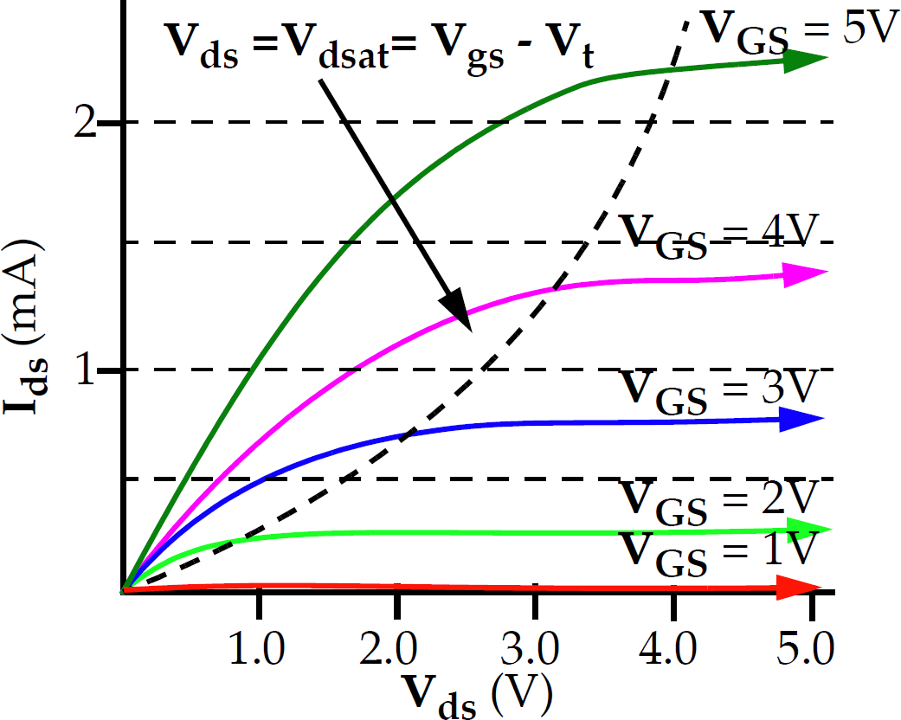
Saturation Mode
© Dr. Samer Arandi - An-Najah National University

Slide 66
Practical Considerations
The I-V characteristics discussed so far neglect many effects that are important in modern
fabrication processes:
Velocity Saturation
We assumed that carrier drift velocity and hence current increase linearly with the electric field between source and drain.
This is only true for weak electric fields, at high electric fields and short channel lengths carrier drift velocity saturates (saturation occurs when carriers reach saturation velocity)
Thus, saturation current is linearly dependent on voltage rather than quadratically dependent
© Dr. Samer Arandi - An-Najah National University

Slide 67
Practical Considerations (cont.)
Mobility Degradation
Strong vertical electric fields resulting from large Vgs reduce carrier mobility μ.
Sub-threshold conduction
We assumed that no current flows from source to drain when Vgs < Vt. In reality this is not true and current drops off exponentially. This current is termed as leakage current
Tunneling
According to quantum mechanics, there is a finite
probability that carriers will tunnel through the gate oxide.
This results in gate leakage current flowing into the gate.
Probability of tunneling drops off exponentially with oxide thickness, and so was negligible until recently.
© Dr. Samer Arandi - An-Najah National University

Slide 68
Practical Considerations (cont.)
Junction leakage
The p-n junctions between S & D and the substrate form diodes.
The well to substrate junction is another diode.
Although these diodes are reverse biased they still conduct a
small amount of current
Temperature
Carrier mobility decreases with temperature
The magnitude of the threshold voltage decreases nearly
linearly with temperature
Junction leakage increases with temperature because Is is
strongly temperature dependent.
Net effect: ON current decreases, OFF current increases,
worse performance at high temperature
© Dr. Samer Arandi - An-Najah National University

Slide 69
Practical Considerations (cont.)
Geometry Dependence
Layout designers draw transistors with some width and length, W_{drawn} and L_{drawn}.
The actual dimensions may differ, due to Polysilicon over-stretching
Effective dimensions should be used rather than drawn dimensions for analysis or values can be significantly off.
Below 0.25μm, transistor orientation and amount of nearby poly affect the effective length
© Dr. Samer Arandi - An-Najah National University

Slide 70
MOS Capacitance
The switching speed of MOS circuits is limited by the time required to charge/discharge the capacitances at the internal nodes
The capacitances must be calculated from
device dimensions and dielectric constants
The values are usually specified in femto- Farads per µmeter of width (fF/µm)
– CG vs. Cg
© Dr. Samer Arandi - An-Najah National University

Slide 71
Types of MOS Capacitance
Thin-oxide Capacitance –
Cg => (Cgs, Cgd,Cgb)
Junction capacitance - Csb and Cdb
Non-linear
voltage-dependant
linear
voltage-independant
Overlap Capacitance – Col
Depletion layer capacitance - under the channel - Cjc (associated with Cgb)
© Dr. Samer Arandi - An-Najah National University

Slide 72
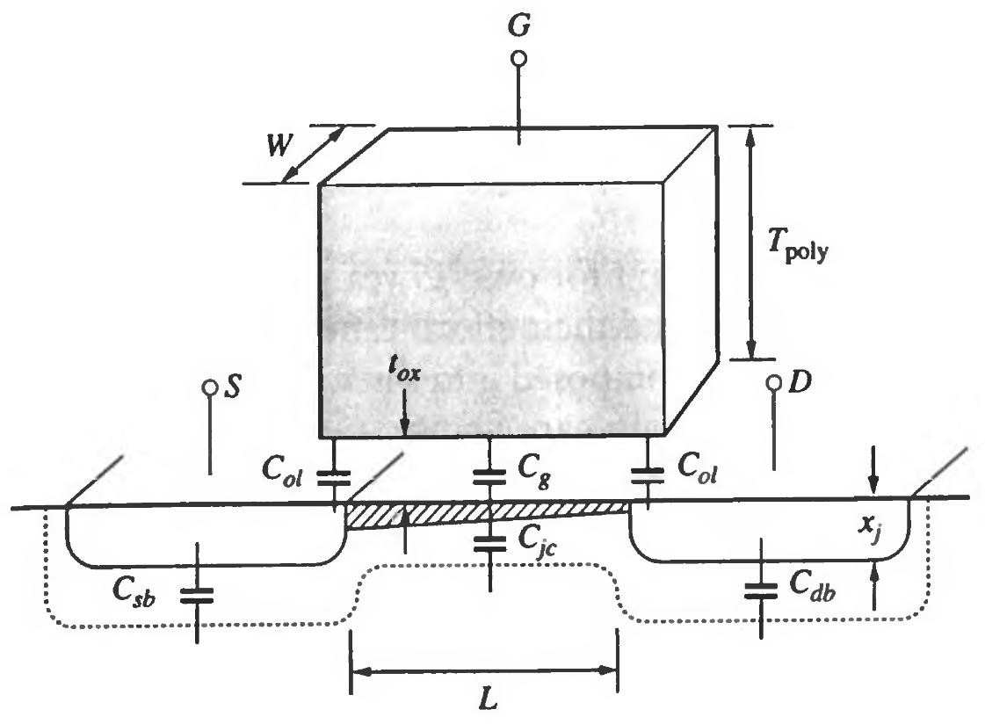
© Dr. Samer Arandi - An-Najah National University

Slide 73
Thin-Oxide Capacitance
The most important capacitance in MOS
The two plates of the capacitor are the gate and the channel
The dielectric is the oxide between the two plates
CG = W *Cg
Cg = Cox *L = ^{εox} * L
tox
© Dr. Samer Arandi - An-Najah National University

Slide 74
Thin-Oxide Capacitance Calculations
In 5 µm technology (L=5 µm), tox = 1100 Å
Cg = Cox*L =((4*8.85x10⁻¹⁴)/110)*5 µm = 1.6 fF/µm
In 0.35 µm technology (L=0.35 µm), tox = 75 Å
Cg = Cox*L =((4*8.85x10⁻¹⁴)/75)*0.35 µm = 1.6 fF/µm
In 0.13 µm technology (L=0.1 µm), tox = 22 Å
Cg = Cox*L =((4*8.85x10⁻¹⁴)/22)*0.1 µm = 1.6 fF/µm
The factor remained constant for over 25 years
– Both L and tox are scaled at the same rate and so their effects cancel each other
© Dr. Samer Arandi - An-Najah National University

Slide 75
Thin-Oxide Capacitance
The gate capacitance is decomposed into three capacitances:
Cgs: gate-to-source capacitance
Cgd: gate-to-drain capacitance
Cgb: gate-to-bulk capacitance
The composition vary depending on whether the device is in cut-off, linear or saturation states
© Dr. Samer Arandi - An-Najah National University

Slide 76
Thin-Oxide Capacitance
Capacitance | Cut-off | Linear | Saturation
Cgb | ½ Cg* | 0 | 0
Cgd | 0 | ½ Cg | 0
Cgs | 0 | ½ Cg | 2/3 Cg
*assuming a VGS = 0 (in the cut-off region Cgb is in series with the depletion capacitance Cjc)
© Dr. Samer Arandi - An-Najah National University

Slide 77
Junction Capacitance
The S and D regions and the substrate forms pn junctions that give rise to two additional capacitances - Csb and Cdb
In addition, a junction capacitance is formed between the inverted channel and the substrate – Cjc
This capacitance depends on the terminal voltage
© Dr. Samer Arandi - An-Najah National University

Slide 78
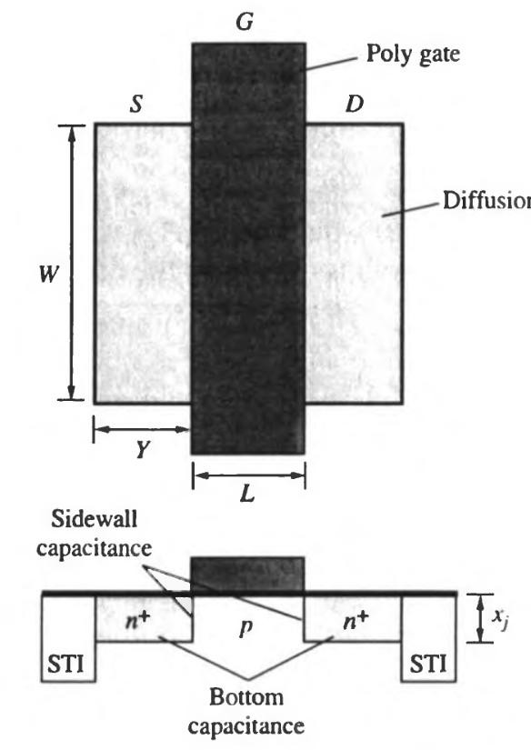
Junction Capacitance
C_{J}: junction capacitance
C_{j0}: zero-bias junction capacitance (fF/cm²)
A: area of the junction = W*(xj+Y) m: the junction grading coefficient (approx. 1/2 for abrupt junctions)
Φ_{B}: built-in junction potential
Cj0 * A
CJ =
VJ ₎m
φB
(1−
(εsi * q) * NA * ND
εsi * q * NA
2*φB
Cj0 =
=
(2*φB)
NA + ND
_{φB =} k *T _{ln} NA * ND
q ni ²
© Dr. Samer Arandi - An-Najah National University

Slide 79
Junction Capacitance
Since the terminal voltages change during dynamic operation we need to calculate the capacitance under such transient conditions
We approximate this capacitance by finding the
large-signal average junction capacitance*:
CJ = Keq *Cj0 * A
φB
Keq = ^{− 2*}
*( φB −V 2 − φB −V1)
V 2 −V1
Keq: dimensionless coefficient
*calculated for a transition between two known voltages, V1 and V2
© Dr. Samer Arandi - An-Najah National University

Slide 80
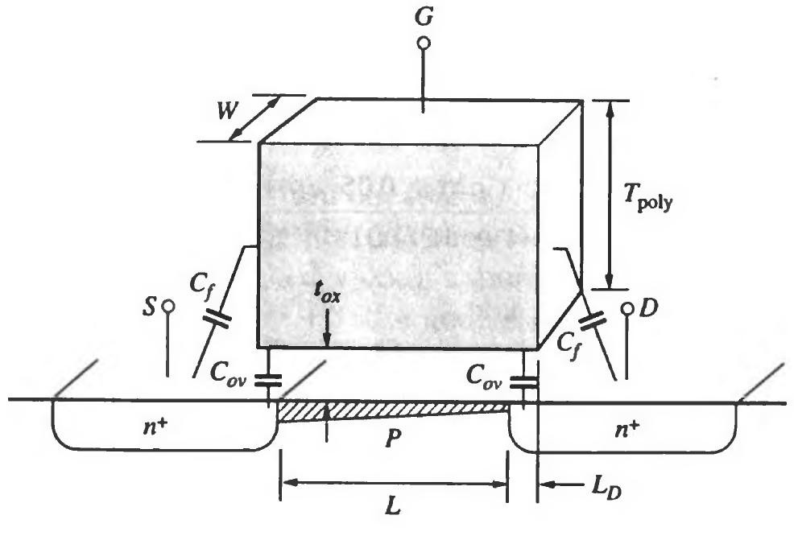
Overlap Capacitance
Voltage-independent capacitance that exists on both sides of the gate
Composed of two components:
diffusion capacitance between the gate and the diffusion extensions of the source
and drain - Cov
fringing capacitance between sidewall of the poly-silicon
and surface of drain and source - Cf
Col = Cov + Cf
© Dr. Samer Arandi - An-Najah National Unive
rsity

Slide 81
Col = Cov + Cf
Overlap Capacitance
_{Cf =} 2εox _{ln(1+} Tpoly₎
π
tox
Cov = Cox * LD
© Dr. Samer Arandi - An-Najah National University

Slide 82
MOS Inverter Static Characteristics
© Dr. Samer Arandi - An-Najah National University

Slide 83
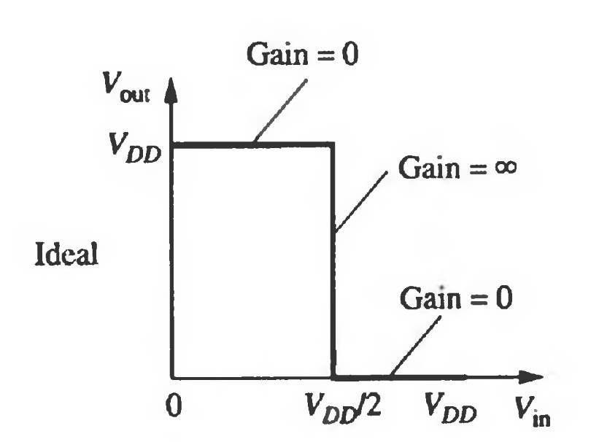
Voltage Transfer Characteristics
In an ideal implementation of an inverter, the two binary levels are ground and V_{DD}.
The output transition between the 1 and 0 states occurs when the input is exactly V_{DD}/2.
DC Voltage Transfer Characteristics
δVout
Gain = _{δV}
in
© Dr. Samer Arandi - An-Najah National University

Slide 84
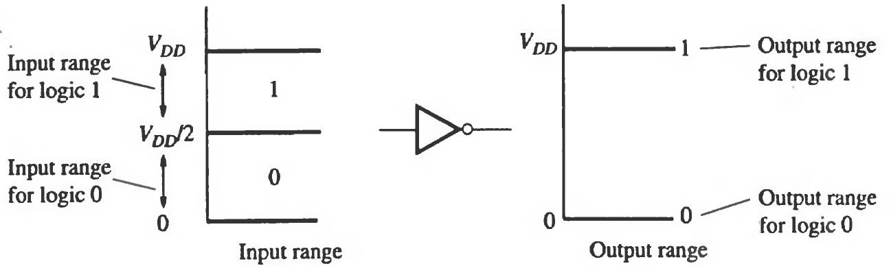
Voltage Transfer Characteristics
Range: voltage interval over which a signal is considered to be
logic 0 or logic 1. For an ideal inverter:
-The input range is very large
-The output range is small
This is desirable as it implies: the input can vary significantly with little or no effect on the output (the gate rejects noise at the input)
© Dr. Samer Arandi - An-Najah National University

Slide 85
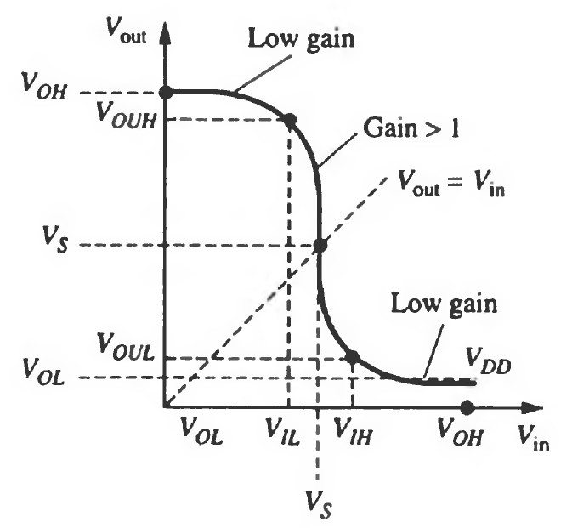
Practical VTC
VOL may not reach GND
VOH may not reach VDD
V_{out} doesn’t switch from VDD
to GND at VDD/2
Vs: point where V_{out} = V_{in}
instead of 3 regions
(0 gain, infinite gain, 0 gain)
we have
(low gain, high gain, low gain)
© Dr. Samer Arandi - An-Najah National University

Slide 86
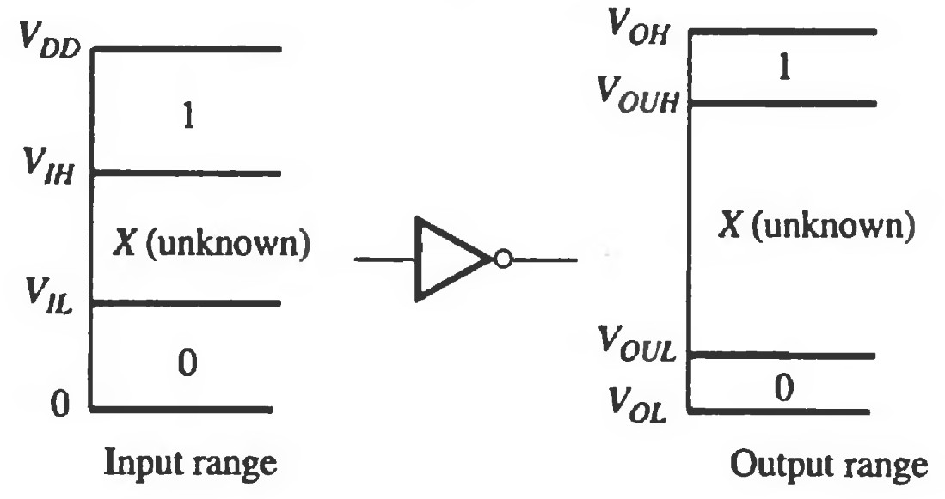
Practical VTC
The input ranges that define 0 and 1 are smaller than the ideal case
0 to V_{IL}
V_{IH} to V_{DD}
The two output ranges are larger than the ideal case
V_{OL} to V_{OUL}
V_{OUH} to V_{OH}
© Dr. Samer Arandi - An-Naja
h National University

Slide 87
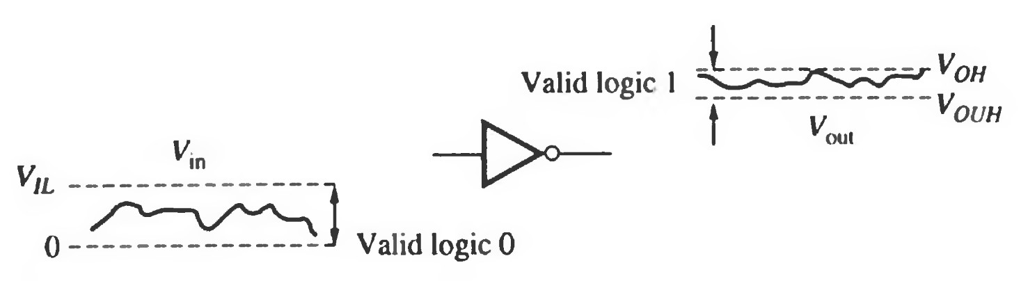
Noise
When the input range is larger than the output range, the gate retains the noise rejection property
i.e. output fluctuation are small even with large input fluctuation
This attenuates the noise when multiple gates are connected successively
© Dr. Samer Arandi - An-Najah National University

Slide 88
Noise Margin Definitions
If the noise amplitude at the input of any logic circuit is smaller than the noise margin of the circuit the noise will be attenuated
Noise may be transferred to logic nodes or interconnecting lines by:
Unwanted capacitive or inductive coupling
Series inductance and resistance in the shared ground and power supply lines
The robustness of a gate depends on:
How much noise can be applied before the gate fails (gate properties)
How much noise actually couples into the gate (environ.)
© Dr. Samer Arandi - An-Najah National University

Slide 89
Noise Margins
The noise margin specifies the range over which the circuit will function properly.
Noise margin metrics:
single-source noise margin (SSNM): assumes a single noise source affecting one logic node (not realistic)
multiple-source noise margin (MSNM): assumes multiple noise sources potentially affecting all nodes (more realistic)
© Dr. Samer Arandi - An-Najah National University

Slide 90
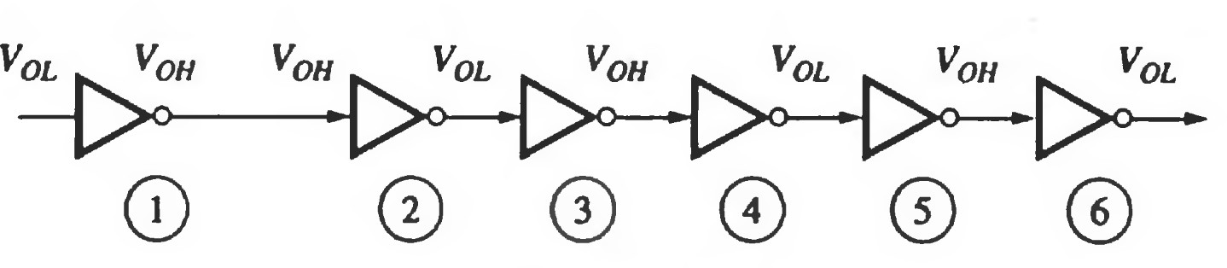
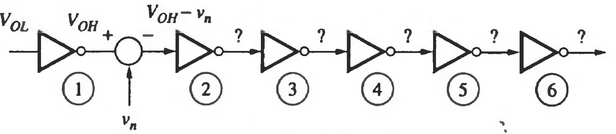
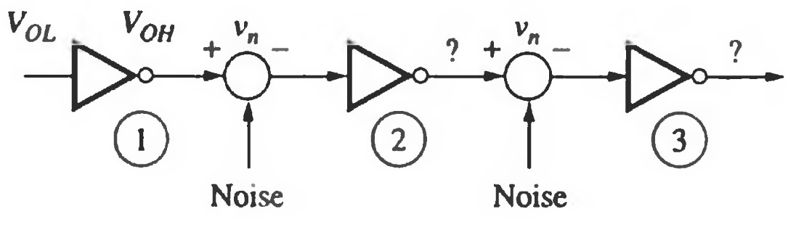
Noise Margins (cont.)
Noiseless System
System with single-stage noise of magnitude Vn
System with multi-stage noise
© Dr. Samer Arandi - An-Najah National University

Slide 91
Noise Margins (cont.)
For a noiseless system:
Vout = f(Vin)
When adding noise Vn the output:
Vout = f(Vin+Vn)
Can be eventually simplified into:
Vout = Noiseless_Output + noise*gain
This implies that if the inverter is operating in the region where:
The gain > 1, noise is amplified (undesired)
The gain < 1, noise is attenuated (desired)
© Dr. Samer Arandi - An-Najah National University

Slide 92
Noise Margins (cont.)
We can define the noise margins by using the VTC points where the gain is 1 to establish the transition points of the range
© Dr. Samer Arandi - An-Najah National University

Slide 93
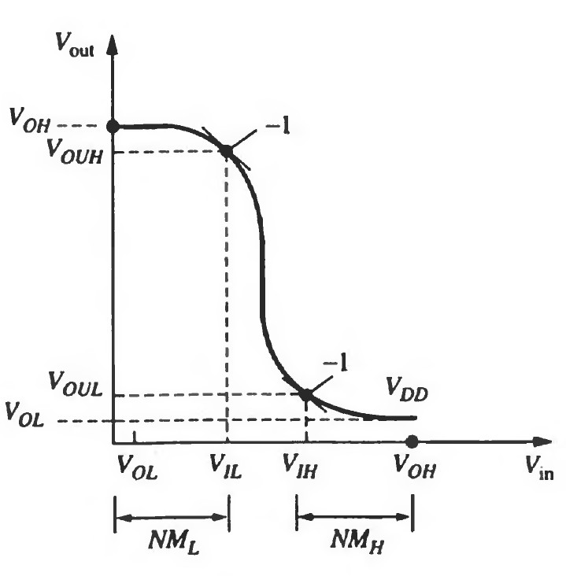
Noise Margins (cont.)
₌ δVout
Inverter
δVin
NM_{H} = V_{OH} - V_{IH} NM_{L} = V_{IL} - V_{OL}
© Dr. Samer Arandi - An-Najah National University

Slide 94
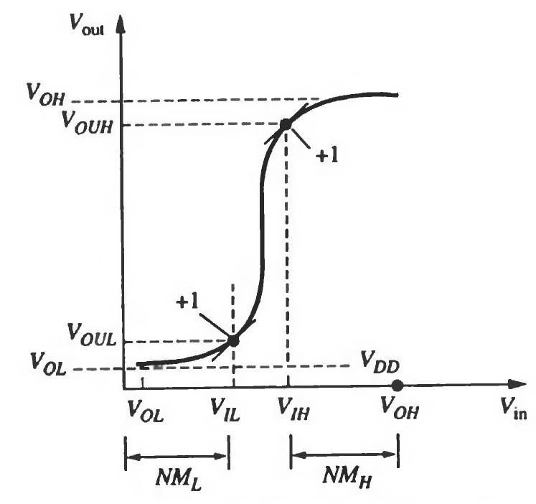
Noise Margins (cont.)
Buffer
^{N}MH ^{= V}OH ^{- V}IH ^{N}ML ^{= V}IL ^{- V}OL
© Dr. Samer Arandi - An-Najah National University

Slide 95
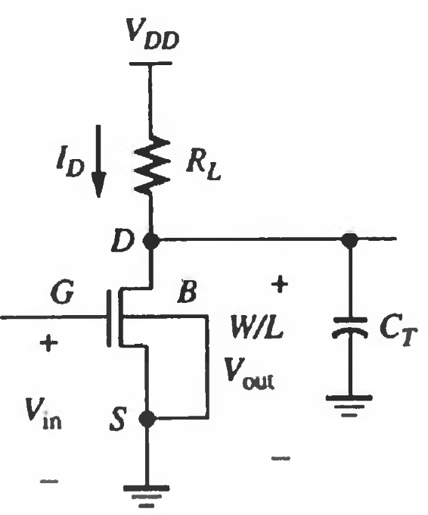
Resistive-Load NMOS Inverter
^{V}in ^{= V}GS
^{V}out ^{= V}DS V_{SB} = 0
V_{T} = V_{T0}
Since I_{G} is negligible I_{R} = I_{D}
© Dr. Samer Arandi - An-Najah National University

Slide 96
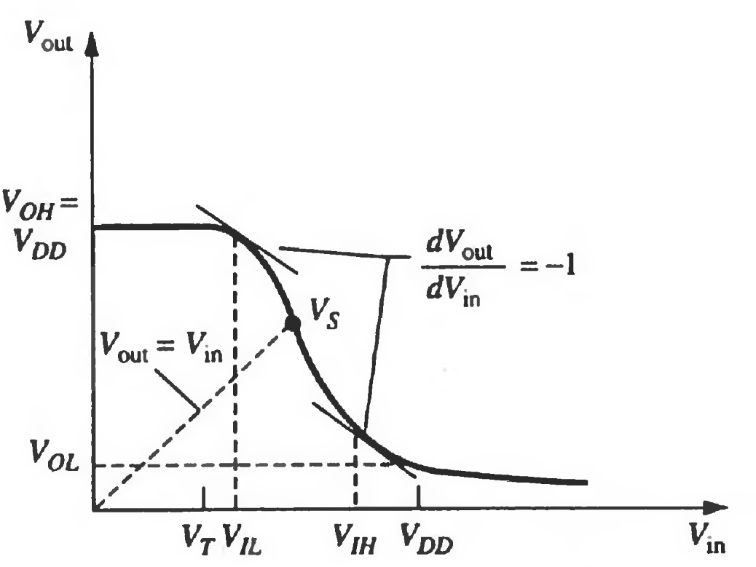
VTC
To calculate the noise margins we find the five critical points on the VTC: V_{OH}, V_{OL}, V_{IH}, V_{IL} and V_{s}
© Dr. Samer Arandi - An-Najah National University

Slide 97
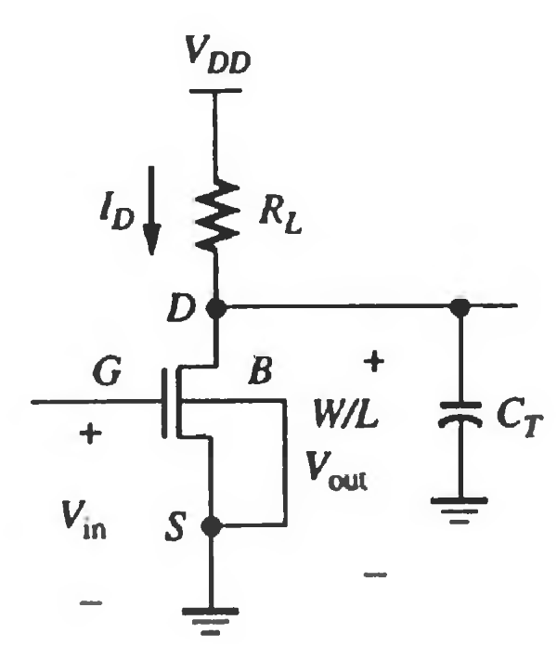
Calculating V_{OH}
To calculate V_{OH} we set the input voltage below V_{T}
Therefore, no current flows
And so:
^{V}OH ^{= V}DD
© Dr. Samer Arandi - An-Najah National University

Slide 98
Calculating V_{OL}
When a logic 1 is applied at the gate input (represented by V_{OH} of a previous gate) the transistor is driven into the linear region.
This implies:
^{I}R ^{= I}DS (linear)
VDD −VOL
K
= [2(V
OH −V
2
T )VOL −VOL]
RL
2
© Dr. Samer Arandi - An-Najah National University

Slide 99
Calculating V_{OL}
VDD
1+ k * RL(VDD −VT )
VOL =
To make V_{OL} small:
increase k (i.e. W/L) [increase area, faster fall- time]
increase R_{L}[increase area, slower rise-time]
Decreasing V_{OL} increases the power marginally, however increasing R_{L} reduces
power
P = I *V = (^{VDD −VOL} )*VDD
RL
© Dr. Samer Arandi - An-Najah National University

Slide 100
Calculating V_{IL}
At V_{in} = V_{IL} the output voltage is near V_{DD} and the transistor is operating in the saturation region.
This implies:
^{I}R ^{= I}DS (saturation)
VDD −VOut ₌ k _{(VIL −VT )}2
RL
2
© Dr. Samer Arandi - An-Najah National University

Slide 101
Calculating V_{IL}
1
k * RL
VIL = VT +
To increase V_{IL}:
Decrease k and R_{L}. However, this increases V_{OL} which is not desirable
Both V_{IL} and V_{OL} shift in the same direction and so it's difficult to affect the NM_{L} significantly
© Dr. Samer Arandi - An-Najah National University

Slide 102
Calculating V_{IH}
When V_{in}=V_{IH} the output voltage is near 0 and the transistor is operating in the linear region
^{I}R ^{= I}DS (linear)
Following a similar procedure we end-up with:
8*VDD
1
VIH = VT +
−
3* k * RL
k * RL
© Dr. Samer Arandi - An-Najah National University

Slide 103
Calculating V_{IH}
8*VDD 1
3* k * RL k * RL
VIH = VT +
−
To decrease V_{IH} we can increase kR_{L}, however, this increases the rising delay and increases the power slightly
Changes in k and R_{L} have no effect on V_{OH} so its possible to increase NM_{H}
© Dr. Samer Arandi - An-Najah National University

Slide 104
NMOS as Load Devices
The resistor load (R_{L}) requires large amount of chip area if realized in a standard MOS process
The area would be more than 100 times that of a transistor!
It would also result in a large Rise Time
Consequently resistors are rarely used as loads in MOS digital circuits
Instead an NMOS transistor is used to perform the function of a pull-up resistor.
© Dr. Samer Arandi - An-Najah National University

Slide 105
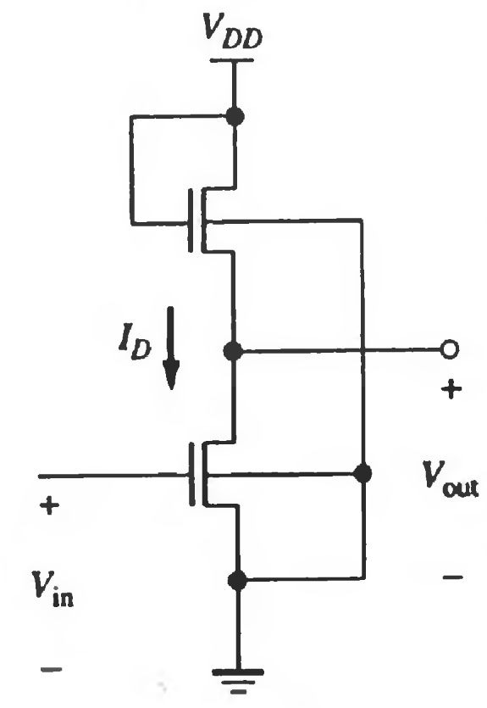
Saturated Enhancement Load Inverter
G of the pull-up is connected to V_{DD}
The transistor is working in the saturation mode or cut-off mode
Pull-up
transistor
The relative sizes of the two transistors determine the output voltages (must ensure V_{OL} is < V_{T})
Pull-down transistor
© Dr. Samer Arandi - An-Najah National University

Slide 106
Saturated Enhancement Load Inverter
Advantages:
Single power supply
Simple Fabrication
Pull-up
transistor
Disadvantages:
V_{OH} is limited to
^{V}DD ^{- V}TL
Pull-down transistor
© Dr. Samer Arandi - An-Najah National University

Slide 107
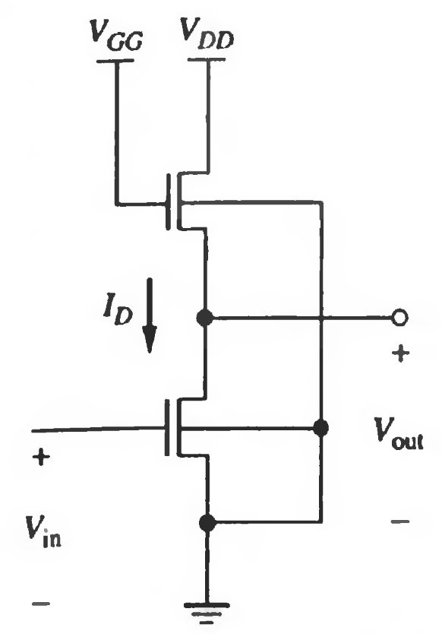
Linear Enhancement Load Inverter
G of the pull-up is connected to V_{GG} such that V_{GG} > V_{DD} + V_{TL}
The transistor is working in the
linear mode for all the range of V_{OH}
V_{OH} can reach to V_{DD}
© Dr. Samer Arandi - An-Najah National University

Slide 108
Linear Enhancement Load Inverter
Advantages:
- V_{OH} can reach to V_{DD}
Disadvantage:
-The extra voltage source is associated with additional interconnections
(more chip area)
- DC power dissipation in the output low state
© Dr. Samer Arandi - An-Najah National University

Slide 109
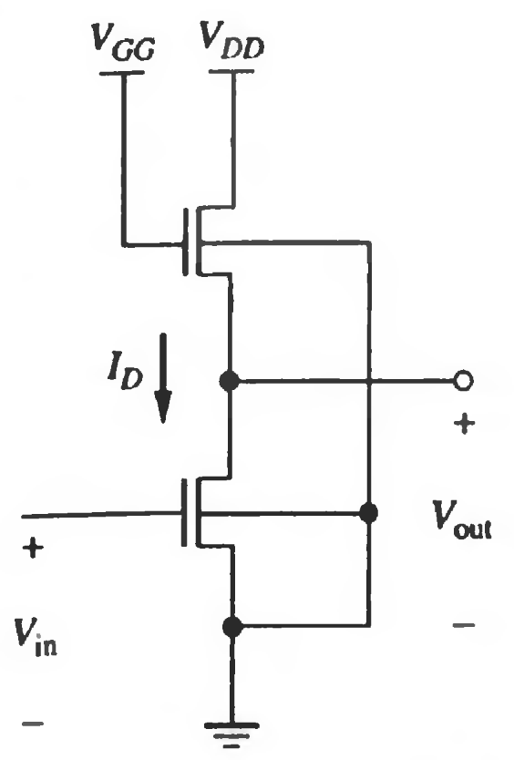
Solution?
Depletion Load Inverter
Better noise margins
Single power supply
Smaller overall layer
More complicated fabrication process
CMOS Inverter
Steady-state power dissipation negligible (only due to leakage currents)
VTC Transition is very sharp (close to an ideal inverter)
© Dr. Samer Arandi - An-Najah National University

Slide 110
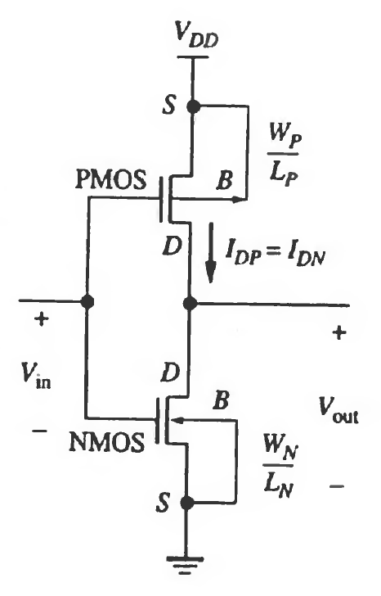
CMOS Inverter
V_{in} is at V_{DD}: the NMOS device is conducting while the PMOS (V_{GS}=0) is cut-off and so V_{OUT} is 0 and I_{DN} is almost zero.
V_{in} is at GND, the NMOS is cut-off while the PMOS is conducting and so V_{out} is equal to V_{DD} and I_{DN} is almost
zero.
V_{OH} = V_{DD}
V_{OL} = 0
large noise margins
© Dr. Samer Arandi - An-Najah National University

Slide 111
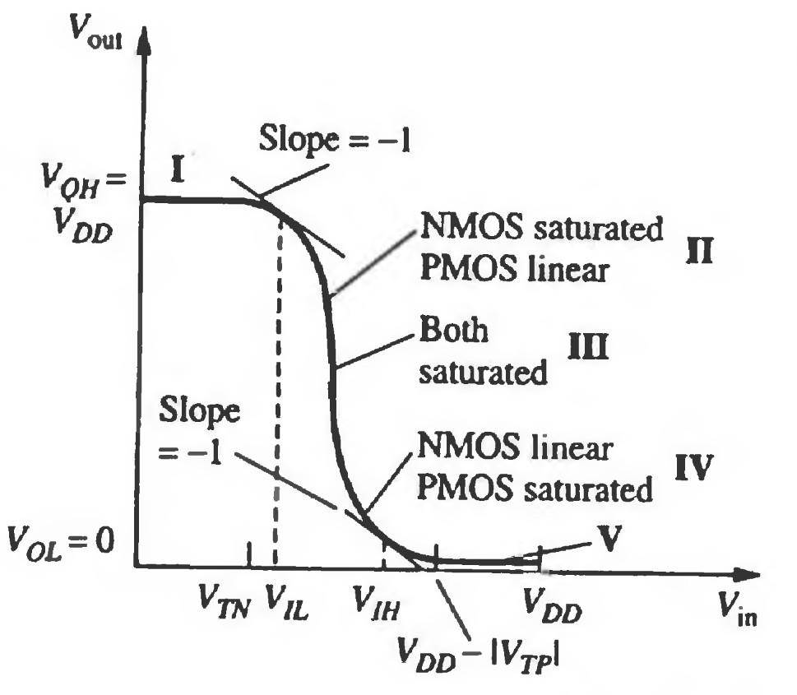
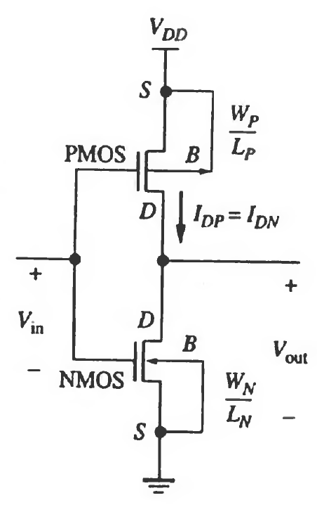
VTC
5 regions
© Dr. Samer Arandi - An-Najah National University

Slide 112
VTC
Region | Vin | Vout | NMOS | PMOS
I | ^{< V}T0,n | ^{V}OH | Cut-off | Linear
II | ^{V}IL | High ≈ V_{OH} | Saturation | Linear
III | V_{s} | Vs | Saturation | Saturation
IV | ^{V}IH | Low ≈ V_{OL} | Linear | Saturation
V | ^{> V}DD^{+V}T0,p | ^{V}OL | Linear | Cut-off
© Dr. Samer Arandi - An-Najah National University

Slide 113
VTC Symmetry
A completely symmetrical VTC is obtained if V_{TP} = - V_{TN} and k_{P} = k_{N}
_{Vs =} VDD− | VTP | +χVTN
1+ χ
WN
μnWN
μpWP
ECN * LN ₌
χ =
WP
ECP * LP
© Dr. Samer Arandi - An-Najah National University

Slide 114
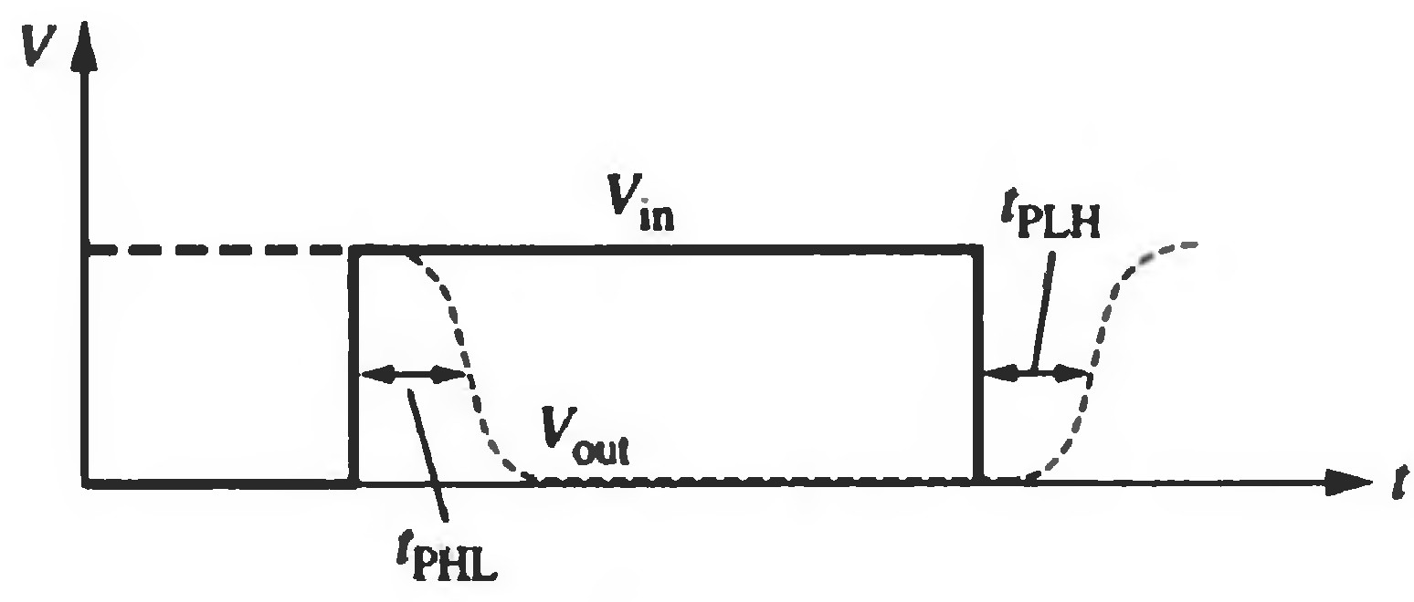
CMOS Inverter Timing
tpHL (propagation delay high to low): time delay between V_{50%} transition of the rising input voltage and the V_{50%} transition of the falling output voltage.
tpLH (propagation delay low to low): time delay between V_{50%} transition of the falling input voltage and the V_{50%} transition of the rising output voltage.
Propagation time delay (tP)
_{tP =} ^{t}PHL ^{+ t}PLH
2
©
Dr. Samer Arandi - An-Najah National University

Slide 115
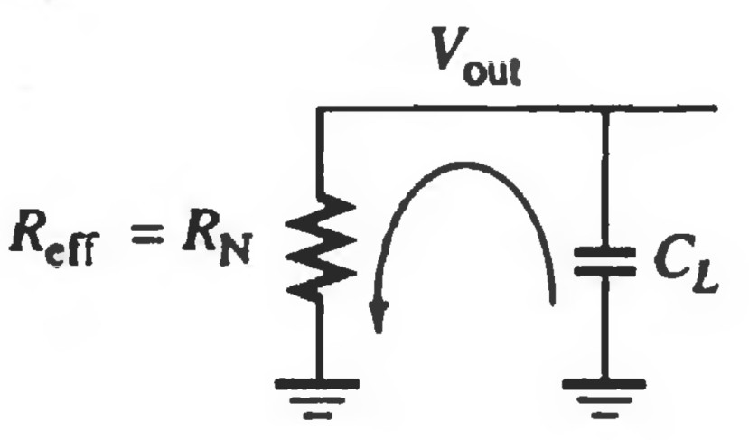
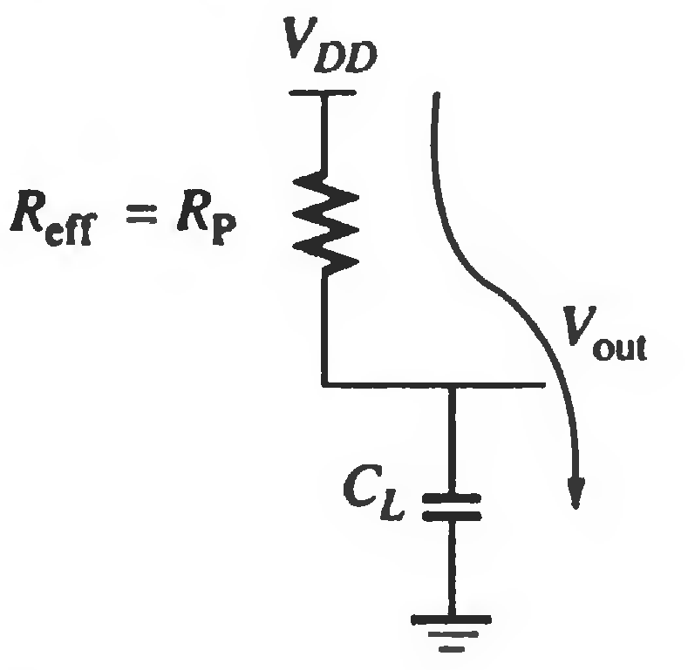
CMOS Inverter Timing
We can model the inverter as an effective on- resistance (R_{eff}) driving a load capacitance C_{L}
When the output is falling:
^{R}eff ^{= R}N
Vout(t) = VDD *e^{-t/RN*CL}
When the output is rising: ^{R}eff ^{= R}P
Vout(t) = VDD *(1− e^{-t/RP*CL} )
In both cases the 50%
occurs at =>
t = 0.69*R_{eff}*C_{L}
© Dr. Samer Arandi - An-Najah National University

Slide 116
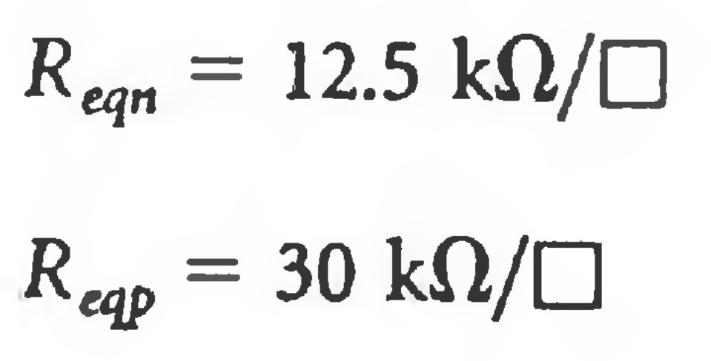
Effective On-Resistance
R_{eff} is inversely proportional to W/L
The NMOS and PMOS have difference R_{eff}.
R_{N} = R_{eqn}*(L_{N}/W_{N}) R_{P} = R_{eqp}*(L_{P}/W_{P})
R_{eqn} is defined in units of L/W
© Dr. Samer Arandi - An-Najah National University

Slide 117
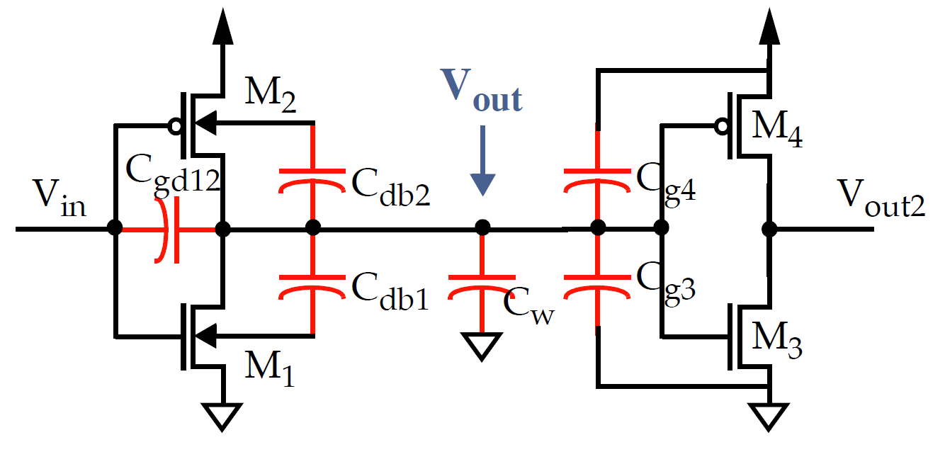
Load Capacitance (C_{L})
C_{L} accounts for (is the sum of) :
the internal capacitance of the inverter
the capacitance of the wiring
intrinsic
– the capacitance of the fan-out
extrinsic
© Dr. Samer Arandi - An-Najah National University

Slide 118
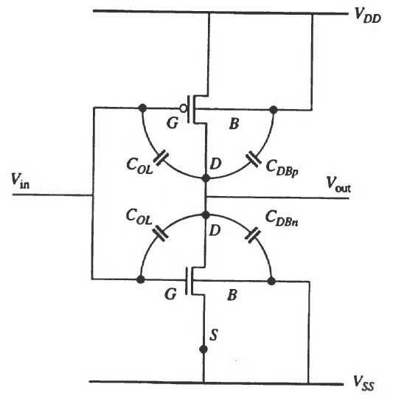
Internal Capacitance
Comprised of the Capacitances connected to the output (D):
Cdb1 and Cdb2 are the junction capacitance (D-to-B)
Since we mostly work in cut-off and saturation Cgd12 (gate capacitance) is almost negligible except from
the overlap
capacitance
© Dr. Samer Arandi - An-Najah National University

Slide 119
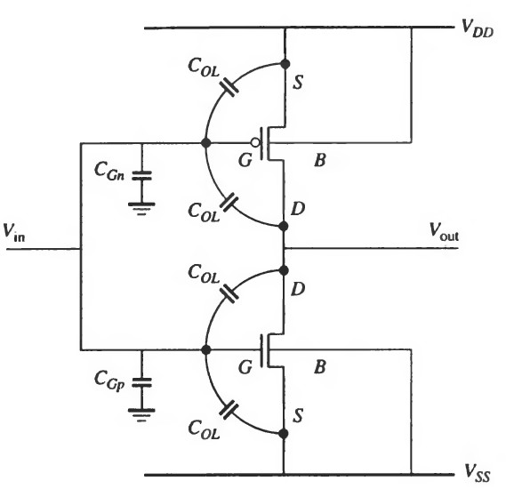
Fan-out Capacitance
The Fan-out capacitance is due to the input of subsequent gates.
This capacitance can be large:
the sum of each of the driven gate capacitances
Each gate capacitance comprises:
gate capacitance
(thin-oxide capacitance)
overlap capacitances
© Dr. Samer Arandi - An-Najah National University

Slide 120
Minimizing Propagation Delay
Reducing CL
Careful layout can reduce this capacitance.
Increase W/L ratio of the transistors.
Warning: doing so increases the intrinsic capacitance
Increase V_{DD} (R_{eq} depends on V_{DD})
The delay of a gate can be modulated by modifying the supply voltage.
This allows the designer to trade off energy dissipation for performance.
However, rising above a certain level yields only a minor improvement.
Also, reliability concerns (oxide breakdown, hot-electron effects) set firm upper bounds.
© Dr. Samer Arandi - An-Najah National University

Slide 121

R_{eq} vs. V_{DD}
© Dr. Samer Arandi - An-Najah National University

Slide 122
t_{p} vs. V_{DD}
5.5
5
4.5
4
3.5
3
2.5
2
1.5
1
t (normalized)
p
0.8
1
1.2
1.4
1.6
1.8
2
2.2
2.4
V
(V)
© Dr. Samer Arandi - An-Najah National University
DD

Slide 123
CMOS Fabrication
© Dr. Samer Arandi - An-Najah National University

Slide 124
CMOS Fabrication
CMOS Technology depends on using both N-Type and P- Type devices on the same chip.
The two main technologies to do this task are:
P-Well
The substrate is N-Type. The N-Channel device is built into a P- Type well within the parent N-Type substrate. The P-channel device is built directly on the substrate.
N-Well
The substrate is P-Type. The N-channel device is built directly on the substrate, while the P-channel device is built into a N- type well within the parent P-Type substrate.
© Dr. Samer Arandi - An-Najah National University

Slide 125
Two more advanced technologies to do this task are becoming more popular for sub-micron geometries where device performance and density must be pushed beyond the limits of the conventional p & n-well CMOS processes.
Twin Tub
Both an N-Well and a P-Well are manufactured on a lightly doped N-type substrate.
Silicon-on-Insulator (SOI) CMOS Process
SOI allows the creation of independent, completely isolated nMOS and pMOS transistors virtually side-by-side on an insulating substrate.
© Dr. Samer Arandi - An-Najah National University

Slide 126
N- & P-Well Method
CMOS Requires that both n-channel (nMOS) and p- channel (pMOS) transistors be built on the same chip substrate.
To accommodate both nMOS and pMOS devices, special regions must be created in which the semiconductor type is opposite to the substrate type. These regions are called wells or tubs.
A p-well is created in an n-type substrate or, alternatively, an n- well is created in a p-type substrate.
In the simple n-well CMOS fabrication technology, the nMOS transistor is created in the p-type substrate, and the pMOS transistor is created in the n-well, which is built-in into the p-type substrate.
© Dr. Samer Arandi - An-Najah National University

Slide 127
N-Well Fabrication Process
The creation of the n-well regions for pMOS transistors, by
impurity implantation into the substrate.
A thick oxide is grown in the regions surrounding the nMOS and pMOS active regions.
The thin gate oxide is subsequently grown on the surface through thermal oxidation.
The creation of n+ and p+ regions (source, drain and channel-
stop implants).
The metallization is created (creation of metal interconnects).
© Dr. Samer Arandi - An-Najah National University

Slide 128
Lithography
Each processing step requires that certain areas are defined on chip by appropriate masks.
Consequently, the integrated circuit may be viewed as a set of patterned layers of doped silicon, polysilicon, metal and insulating silicon dioxide.
In general, a layer must be patterned before the next layer of material is applied on chip.
The process used to transfer a pattern to a layer on the chip is called lithography.
© Dr. Samer Arandi - An-Najah National University

Slide 129

Basic Steps
Thermal oxidation of the silicon surface: an oxide layer of about 1 micrometer thickness is created on the substrate, see (b).
The entire oxide surface is covered with a layer of photoresist, which is a light-sensitive, acid-resistant organic polymer, initially insoluble in the developing solution (c).
The photoresist material is exposed to ultraviolet (UV) light, the exposed areas become soluble so that the they are no longer resistant to etching solvents.
To selectively expose the photoresist, we have to cover some of the areas on the surface with a mask during exposure. Thus, when the structure with the mask on top is exposed to UV light:
areas which are covered by the opaque features on the mask are shielded.
areas where the UV light strikes the photoresist, it is “exposed” and becomes soluble in certain solutes (d).
© Dr. Samer Arandi - An-Najah National University

Slide 130
PhotoResist
PhotoResist normally comes in powder form, which is insensitive to light. It is reconstituted into liquid form by adding a solvent, typically alcohol.
The wafer is mounted on a turntable, spinning slowly, and the photoresist is discharged into its center. Centrifugal force spreads the resist outward across the wafer. The thickness that remains on the wafer is a function of the rate of wafer spin and the viscosity of the photoresist. The thickness is monitored by light diffraction, which is used to adjust the spin rate to reach the correct PR thickness.
Phase Interference gives
Photoresist Thickness
After the PR is applied, the wafer is heated (~160C) to evaporate the solvent, leaving a smooth solid coating.
The type of photoresist which is initially insoluble and becomes soluble after
exposure to UV light is called positive photoresist.
© Dr. Samer Arandi - An-Najah National University

Slide 131

Following the UV exposure step, the
unexposed portions of the photoresist can be
removed by a solvent.
The silicon dioxide regions which are not
covered by hardened photoresist can be
etched away either by using a chemical solvent (HF acid) or by using a dry etch (plasma etch) process (e).
At the end of this step, we obtain an oxide
window that reaches down to the silicon surface (f).
The remaining (unexposed) photoresist can
be stripped from the silicon dioxide surface by using another solvent, leaving the patterned silicon dioxide feature on the surface, see (g).
The fabrication of semiconductor devices requires several such pattern transfers to be performed on silicon dioxide, polysilicon, and metal. The basic patterning process used in all fabrication steps, however, is quite similar to the one shown.
© Dr. Samer Arandi - An-Najah National University

Slide 132

Summary
9 steps to make this simple hole:
Oxidize silicon surface
Deposit photoresist
Anneal photoresist
Mount mask above silicon
Expose to UV light
Develop photoresist
Etch photoresist exposed to UV
Etch SiO₂ through photoresist hole
Remove photoresist
© Dr. Samer Arandi - An-Najah National University

Slide 133

Making a CMOS device
The oxidation of the silicon (field oxide) is
created on the surface (b).
The field oxide is selectively etched to expose the silicon surface on which the MOS transistor will be created (c).
The surface is covered with a thin, high-quality
oxide layer which will eventually form
the gate oxide of the MOS transistor (d).
A layer of polysilicon (polycrystalline silicon) is deposited (e). Polysilicon is used
both as gate electrode material for MOS transistors and also as an interconnect medium in silicon integrated circuits. The resistivity of polysilicon is reduced by doping
it with impurity atoms.
The polysilicon layer is patterned and etched to
form the interconnects and the MOS transistor
gates (f).
© Dr. Samer Arandi - An-Najah National University

Slide 134

Making a CMOS device
The thin gate oxide not covered by polysilicon is also etched away, which exposes the bare silicon surface on which the source and drain junctions are to be formed (g)
The entire silicon surface is then doped with a high concentration of impurities, either through diffusion or ion implantation (in this case with donor atoms to produce n-type doping).
(h) shows that the doping penetrates the exposed areas on the silicon surface to create two n-type regions (source and drain junctions) in the p-type substrate. Note that the polysilicon gate, which is patterned before doping actually defines the precise location of the channel region and, hence, the location of the source and the drain regions. (self-aligned process)
Once the source and drain regions are completed, the entire surface is again covered with an insulating layer of silicon dioxide (i).
The insulating oxide layer is then patterned in order to provide contact windows for the drain and source junctions (j).
© Dr. Samer Arandi - An-Najah National University

Slide 135

Making a CMOS device
The surface is covered with evaporated aluminum (5000A) which will form
the interconnects (k).
Finally, the metal layer is patterned and etched, completing the interconnection of the MOS transistors on the surface (l).
© Dr. Samer Arandi - An-Najah National University

Slide 136

The N-Well Fabrication Process
We have covered the basic process steps for pattern transfer through lithography, and gone through the fabrication procedure of a single n-type MOS transistor.
The n-well CMOS integrated circuits fabrication follows the same steps, however for creating two devices: N-MOS and P- MOS.
The first lithographic mask defines the n-well region. Donor atoms, usually phosphorus, are implanted through this window in the oxide. Once the n-well is created
The rest of the steps follows similarly
© Dr. Samer Arandi - An-Najah National University

Slide 137
Operational Amplifiers
Digital Electronic Circuits 66332
Computer Engineering Department
Analog Interface
Dr. Manar Qamhieh Fall 2015
1
NOTE: the content of these slides is collected from various sources (books, websites and author pages), no originality is claimed.

Slide 138
Analog Interface
Interface: is to connect devices in a compatible manner
Everything in nature is analog
Digital circuits are more stable and more reliable than analog circuits
Analog Interface: is the techniques that are used to allow digital circuits to monitor and control analog devices.

Slide 139
Analog Interfacing Applications
Analog Comparator:
An op-amp circuit to know if the analog signal has exceeded a particular threshold or not.
Open-Collector Buffer for DC devices or Electromechanical Solid-state relay for AC devices:
To control the ON/OFF state of an analog device.
Digital-to-Analog (DAC) and Analog-to-Digital (ADC) circuits:
The interface of such circuits require the interface between an Op-Amp and a logic gate.

Slide 140
Operational Amplifier (Op-Amp)
Op-Amp circuit is invaluable for the processing of analog signals.
It processes signals in the same way logic gates process digital signals.
It can be used to amplify, attenuate and offset analog signals.
It can be used to separate different elements of a circuit from each others.
It is the universal analog IC because it performs all analog tasks:
comparator, one-bit A/D, amplifier, level-shifter, filter, current source, voltage source and many other applications.

Slide 141

Op-Amp: Pin Description
Op-Amps are differential amplifiers where the output is dependent on the voltage difference applied to its two inputs.
Op-Amp is designed to be an almost ideal control device (a voltage-controlled voltage source).
Pin Description
Two input pins
Two power supply pins
An output pin

Slide 142
Op-Amp: Pin Description
Input port consists of an inverting input V(-) and a non-inverting input V(+). These values can be positive or negative based on the circuit.
The difference voltage V_{id} = V(+) - V(-)
Power supply pins are V+ and V-
Typical values are ±12v and it may be as high as ±18v.
Output voltage is dependent on V_{id}, and it is limited to approximately 1v less than the supply voltage. These values are often referred to as ±V_{sat}.

Slide 143

Op-Amp: Idealized Abstract Model
Input impedance is infinity.
Output impedance is zero.
No connection between input & output (open-loop).
The Open-loop gain A_{OL} (the factor by which the input voltage is amplified)
is infinity.
^{V}out ^{= A}OL ^{* V}id
This is the mathematical representation of a voltage-dependent voltage source controlled by V_{id}
Input circuit is separated from the output circuit.

Slide 144
Op-Amp: Abstract Model
At low frequencies, A_{OL} is between 100 and 100,000 at dc. Hence, It is normal for an open-loop op-amp circuit to operate in saturation
^{V}out ^{= ±V}sat
For an output not to be in saturation, V_{id} should be as small as:
V_{id} < (V_{sat} / A_{OL})
Accordingly, if V_{sat} = +11v and A_{OL} = 100,000, then V_{id} must be less than 110µv.

Slide 145

Ap-Amp: Open-Loop Saturation Mode
Without feedback, the output of an op-amp is always in saturation.
Large gain saturates the output with only tiny difference voltage on the input port.
The output is either +V_{sat} or -V_{sat}, hence the operation is nonlinear.

Slide 146


Op-Amp: Open-Loop Output Voltage
Tiny input difference voltage (±50µv)
Output has linear parts, but signal get trimmed when voltage saturates
10

Slide 147

Op-Amp: Open-Loop Output Voltage
Input difference voltage (±5v)
Output signal is pulse like, since linear parts are tiny when compared to saturated parts
11

Slide 148
Op-Amp: Closed-Loop Configuration
An Op-Amp operates in closed-loop when a portion of its output is fed back to its inverting input pin V(-).
--negative feedback--
Normally in Closed-Loop operation, the op-amp responds
linearly to its input.

Slide 149

Op-Amp: Why Negative Feedback?
We can add a resistor and a capacitor to model the accumulation of charge in an op-amp.
This is not an accurate representation of the inside of an op-amp, but it is a model of how an op-amp works!

Slide 150


Op-Amp: Why Negative Feedback?
Negative feedback
If V_{i} suddenly increases
V_{O} = A_{OL}(V_{i}-V₋) increases
Current flows into capacitor (charges)
V_{O} gradually increases
the difference (V₊-V₋) decreases
Less current flows and V_{O} approaches a final value equal to V_{i}

Slide 151


Op-Amp: Why Negative Feedback?
Negative feedback
If V_{i} suddenly decreases
V_{O} = A_{OL}(V_{i}-V₋) decreases
Current flows out of the capacitor (discharges)
V_{O} gradually decreases
the difference |V₊-V₋| decreases
Less current flows and V_{O} approaches a final value equal to V_{i}

Slide 152


Op-Amp: Why Negative Feedback?
Positive feedback
If V_{i} suddenly increases
V_{O} = A_{OL}(V₊-V_{i}) decreases
Current flows out of the capacitor (discharges)
V_{O} gradually decreases
The difference (V₊- V_{i}) increases

Slide 153


Op-Amp: Why Negative Feedback?
Positive feedback
If V_{i} suddenly decreases
V_{O} = A_{OL}(V₊-V_{i}) increases
Current flows into the capacitor (charges)
V_{O} gradually increases
The difference (V₊- V_{i}) increases
Positive feedback of an op-amp is unstable

Slide 154


Op-Amp: Inverting Amplifier
Summing node
V_{in} is applied to R_{a} and it is not V_{id}
Key assumptions:
if output is not saturated, V_{id} must be nearly 0v (less than 110µv)
if V_{id} = 0, the summing node must be at 0v (virtual ground)
No current flows into the op-amp inputs (typically,
input resistance of op-amp pins are greater than 1MΩ)

Slide 155
Op-Amp: Inverting Amplifier
For A_{OL} ≅ 100,000, and the ratio R_{a} / (R_{a}+R_{b}) not less than 0.001. Then:
V_{out} ≅ - (R_{b} / R_{a}) * V_{in}
The relation between the input and the output voltage is almost independent Open-Loop gain A_{OL} of the Op-Amp, and dependent only on resistor ratio.
The Closed-Loop gain A_{CL} of this circuit is
A_{CL} = - R_{b} / R_{a}

Slide 156

Op-Amp: Non-Inverting Amplifier
The input voltage V_{in} is connected to V(+) pin of the Op-Amp.
Key assumptions:
if op-amp is not saturated, then V_{id} is so small (≅ 0v)
The summing node is biased at a voltage equal to
^{V}in
Input current of op-amp is zero.

Slide 157
Op-Amp: Non-Inverting Amplifier
For large value of Open-loop gain (A_{OL} ≅ 100,000):
V_{out} ≅[1+ (R₂ / R₁)] *V_{in} The closed-loop gain A_{CL} of this circuit is:
A_{CL} = 1 + R₂ / R₁

Slide 158
Op-Amp: Choice of Resistors
The gain of closed-loop circuits is based on the ratio of the resistors and not on their actual values.
The designer can choose any desired value within practical limits.
The values of resistors determine the current drain and the effect stray capacitance will have.
If values of resistors are too low
higher current is required for Op-Amp operation, which leads excessive dissipation.
self-heating of the chip,
If values of resistors are too high
an increase in noise and parasitic capacitances
leads to instability and oscillation

Slide 159
Op-Amp: Closed-loop Circuits
Advantages of closed-loop circuits (inverting & non-inverting):
V_{out} is not dependant on A_{OL}, but on the values of resistors.
Resistors are more stable, reliable and very insensitive to temperature than A_{OL}.
It becomes a precision circuit, because A_{CL}is dependant on passive components (resistors) which can be very accurate.
Disadvantage:
Closed-Loop gain A_{CL} is much less than the Open-Loop gain A_{OL}. A_{CL} is between 1 and 1000.

Slide 160
Op-Amp: Closed-Loop Circuits
The power supply pins V⁺ and V⁻ are necessary to power the op-amp
The op-amp uses current from the power supplies to regulate the output voltage and to supply the necessary output current.
They are not included in the analysis of closed-loop circuits, because:
the used KCL calculation does not yield a useful relation.
calculating the current through a voltage source rarely provides useful insights. A voltage source can support any current.

Slide 161

Op-Amp: Bandwidth
Typically, op-amps are used for comparatively low frequencies (where A_{OL} is large ≃+100, 000).
At high frequencies, the gain falls below unity (A << 1).
Op-Amp bandwidth depends on the process used to make the op-amp.
BJT op-amps have the highest bandwidth and current drain.
MOSFET op-amps the lowest bandwidth and current drain.

Slide 162
Op-Amp: Bandwidth
In closed-loop circuits, we assumed that A_{OL} is so large so as to calculate the Closed-loop Gain A_{CL}.
At high frequencies, when A drops below (R₂+R₁)/R₁ (where R₁ is the input resistance), A_{CL} drops too.
The frequency at which A_{CL} falls below the ideal gain is called the closed- loop bandwidth f_{CL}.

Slide 163
Op-Amp: Non-Inverting Bandwidth
f_{CL} = f_{U} / A_{N}
where f_{U} is the unity gain frequency and A_{N} is the noise gain
The noise gain is modeled as a voltage source at the positive input of the op-amp. Hence:
A_{N} = A_{CL} = (R₁+R₂) / R₁

Slide 164
Op-Amp: Non-Inverting Bandwidth
Example:
Consider a non-inverting amplifier having a f_{U} = 10MHz and R₁ = R₂ = 10㏀. What is its closed-loop bandwidth f_{CL}?
f_{CL} = 5MHz

Slide 165
Op-Amp: Non-inverting Bandwidth
Unity gain frequency is called the Gain-Bandwidth-Product (GBP).
The product of Noise Gain A_{N} and bandwidth f_{CL} is constant and bounded by GBP.
If you need:
a higher A_{N}, then the bandwidth f_{CL} drops.
a higher bandwidth, then you must choose a lower gain.
both higher gain and bandwidth, then you need to pick an op amp with a higher GBP (f_{U}) on its data sheet.

Slide 166
Op-Amp: Inverting Bandwidth
The bandwidth frequency f_{CL} of inverting circuit has the same value of non- inverting frequency.
f_{CL} = f_{U} / A_{N}, where A_{N} = (R₁+R₂) / R₁
Disadvantage of inverting circuit:
signals are amplified by R₂/R₁ ratio, but the bandwidth is dependent on the larger ratio (R₁+R₂)
/R₁
Previous Example:
A_{CL} is equal to -10k/10k = -1, while A_{N} = 2. Hence, f_{CL} = 10MHz / 2 = 5MHz

Slide 167

Op-Amp: Unity Gain Buffer
In a non-inverting amplifier with A_{CL} = (R_{in}+R₁)/R_{in}
If R_{in} is very large w.r.t. R₁, then A_{CL} becomes 1
V_{out} = V_{in} → this circuit is a unity gain buffer
R_{in} is usually deleted, while R₁ can be shorted.
R₁ (usually 20kΩ) is included in many buffer designs to protect the inverting input from an over voltage

Slide 168

Op-Amp: Application of Unity Gain Buffer
Using a variable voltage to control a motor
From a power supply voltage = 15v, we need 7.5v for the motor.
We can use a voltage divider with two equal resistors
The voltage of the motor depends on the resistance of the motor.
For example, if the resistance of the motor is equal to 100Ω, then the voltage of the motor will be very close to 0.

Slide 169

Op-Amp: Application of Unity Gain Buffer
The use of a unity gain buffer separates the input circuit from the output.
The voltage of the motor will stay 7.5v no matter what the resistance of the motor.
The resistance of the motor specifies the maximum current to pass through the motor.

Slide 170

Op-Amp: Summing Inverter
It is an amplifier with multiple inputs.
It sums the effects of its inputs.
V_{out} = -[V₁/R₁ + V₂/R₂ + ...] * R_{F}
This circuit is equivalent to a three-channel amplifier with each channel having a separate gain (-R_{F}/R_{n})

Slide 171

Op-Amp: Differential Amplifier
It amplifies the difference between signals applied to the inputs.
By using superpositioning and assuming that R_{G} = R_{G’} and R_{F} = R_{F’}
Vout = (V₁ - V₂) * R_{F} / R_{G}
This circuit rejects the common-mode portion of the input signal
if noise voltages appear between grounds, the noise will be suppressed by the common-mode rejection (CMR) of the differential amplifier.

Slide 172
Op-Amp: Differential Amplifier
For proper operation, input resistors (R_{G} & R_{G’}) and feedback resistors (R_{F} & R_{F’}) must be matched.
The CMR of the differential circuit depends on this matching.
Problem:
If the driving impedance (from V1 and
V2) is not low compared to input resistors,
then additional errors will be introduced to the circuit which affect the ratio of resistors and the operation of the circuit.

Slide 173

Op-Amp: Differential Amplifier
Solution:

Slide 174
Op-Amp: Instrumentation Amplifier
High gain differential amplifiers with high input impedance and a single ended output.
Eliminates the need for input impedance matching.
Low noise and very high common-mode rejection ratio.
Suitable for use in measurement and test equipments where it is mainly used to amplify very small differential signals from certain kinds of transducers or sensors.
Provides great accuracy and stability of the circuit.

Slide 175


Op-Amp: Instrumentation Amplifier

Slide 176
Op-Amp: Video Amplifier
Video signals can suffer deterioration over relatively short cable distances.
Video amplifiers are used to compensate for that loss.
Video signals contain high frequencies.
These signals use coaxial cable to transmit and receive signals.
The used cable has a characteristic impedance of 75Ω.
In video amplifiers, op-amps must have input and output impedances matching the 75Ω
To prevent reflections which cause distortion and ghosting of video signals

Slide 177

Op-Amp: Video Amplifier
Non-inverting circuit is used.
R_{IN} = 75Ω (since input impedance of op-amp is very high).
R_{F} and R_{G} have high values (in kΩ) to have minimal affect on input or output impedances.
A matching resistor R_{M} is placed in series with the op-amp output so as to raise output impedance to 75Ω.
A terminating resistor R_{T} is placed at the input of the next stage to match the cable.

Slide 178
Op-Amp: Video Amplifier
R_{M} = R_{T}
they form a voltage divider of 1/2
Very often, R_{F} is selected to be equal to R_{G}, so as the non-inverting circuit has a gain A_{CL} = 2
Hence, the video amplifier has a unity gain (2 * ½ = 1)

Slide 179

Op-Amp: Input Offset Voltage V_{OS}
Ideal:
if both inputs of an op amp are at exactly the sam voltage, then the output should be at zero volts.
Practical:
The input stage of the op amp consists of a differential pair of transistors.
If the two transistors are not perfectly matched,
this mismatch will show up as a non-zero DC offset at the output.
e

Slide 180

Op-Amp: Input Offset Voltage V_{OS}
Input Offset Voltage V_{OS} is a small differential voltage which is applied to the inputs of an op-amp to force the output to zero.
V_{OS} is modeled as a voltage source in series with the non-inverting input of the op- amp.

Slide 181
Op-Amp: Input Offset Voltage V_{OS}
Ranges
Chopper Stabilized / Auto-zeroed Op Amps:
General Purpose Precision Op Amps:
Best Bipolar Op Amps:
Best JFET Input Op Amps:
High Speed Op Amps:
Untrimmed CMOS Op Amps:
DigiTrim™ CMOS Op Amps:
<1µV
50-500µV
10-25µV
100-1,000µV
100-2,000µV
5,000 - 50,000µV
100µV - 1,000µV

Slide 182
Op-Amp: Input Offset Voltage V_{OS}
Input Offset Voltage V_{OS} varies with temperature.
TC_{VOS} is its temperature coefficient, or drift.
Offset drift is affected by the offset adjustments to the op-amp.
Most op-amps have a specified value of TC_{VOS}
Typical drift values for a range of general purpose precision op amps lie in the range 1-10 µV/°C
Maximum V_{OS} may be provided over the operated range of temperature.
It is less useful because there is no guarantee that TC_{VOS} is constant or monotonic.
The Offset Voltage V_{OS} changes as time passes (aging).
Generally, aging is specified in µV/1000 hours.
It is proportional to the square root of the elapsed time.

Slide 183

Op-Amp: Measuring Input Offset Voltage V_{OS}
Measuring V_{OS} (µv) requires that the circuit does not introduce more error than V_{OS} itself.
The circuit amplifies the input offset voltage by the noise gain of 1001.
The V_{out} is measured using an accurate digital voltmeter.

Slide 184

Op-Amp: Adjusting V_{OS} (Null Pins)
Many single op amps have pins available for optional offset null.
Two pins are joined by a potentiometer, and the wiper goes to one of the supplies through a resistor,
Wiper connection may be to either +V_{S} or -V_{S} depending on the op amp.
Values for R₁ and R₂ depend on op amp.
Use to null out the op amp input offset voltage, not the overall system offsets.
There may be high gain from offset pins to output.
Nulling offset causes increase in offset temperature coefficient, approximately 4 µV/°C for 1mV offset null for FET input amplifiers
48

Slide 185

Op-Amp: Adjusting V_{OS} (External Method #1)
Injecting current into the inverting input of \n inverting amplifier circuit.
Disadvantage
a possible increase in noise gain, due to the parallel path of R₃ and the potentiometer resistance.
Noise gain may be reduced by making ±V_{R} large enough so that the R₃ value is much greater than R₁II R₂
if the power supplies are stable and noise-free, they
can be used as ±V_{R}. Otherwise, separate regulated low noise (filtered) sources should be used.

Slide 186

Op-Amp: Adjusting V_{OS} (External Method #2)
injecting a small offset voltage into the non-inverting input.
Advantage
no noise gain increase
Disadvantage
It requires adding R_{P}
If the op amp has matched input bias currents, then R_{P} should equal R₁II R₂ (to minimize the added offset voltage). Otherwise, R_{P} should be less than 50Ω.

Slide 187

Op-Amp: Adjusting V_{OS} (External Method #3)
Injecting a small offset voltage when using an op amp in the non-inverting circuit.
It works well for small offsets, where R₃ can be made much greater than R₁.
The signal gain might be affected as the offset potentiometer is adjusted.
The gain may be stabilized, if R₃ is connected
to a fixed low impedance reference voltage sources, ±V_{R}.

Slide 188

Op-Amp: Input Bias Current
Ideal Op-Amp:
No current flows into input terminals
Practical Op-Amp:
There are two input bias currents I_{B+} & I_{B-}
I_{B} can vary from 60 fA to many µA, depending on the device.
Some structures have well-matched I_{B}, others do not.
In some structures, I_{B} varies little with temperature.
Some structures have I_{B} which may flow in either direction.
Bias current is a problem for the op amp user
it flows in external impedances and produces voltages, which add to system errors.

Slide 189
Op-Amp: Input Offset Current I_{OS}
I_{OS} is the difference between the two input bias currents.
○
^{I}OS ^{= I}B+ ^{- I}B-
I_{OS} is meaningful where the two individual bias currents are fundamentally reasonably well-matched.
This is true for most voltage feedback (VFB) op amps.
Op-Amp’s input stages comprise of two complementary parallel stages which have bias currents that change direction as the common-mode voltage passes through the transition region.
Bias and offset currents for these devices are especially difficult to specify, other than simply giving a maximum positive/negative value.

Slide 190

Op-Amp: Internal Bias Current Cancellation
Necessary bias currents are provided via an internal current source.
External current flowing in the input terminals of the op-amp is the difference current between the base current and the current source.
Pros
Low offset voltage and drift, low bias current and voltage noise.
Cons
Poor bias current match, higher current noise, not very useful at high frequencies.
Most modern precision bipolar input stage op amps use some means of internal bias current compensation.
54

Slide 191
Op-Amp: Internal Bias Current Cancellation
In many cases, the bias current compensation feature is not mentioned on data sheets, and a simplified schematic isn't supplied.
How to verify?
Examine the bias current specification.
If bias current is specified as a “±” value, the op amp is most likely compensated for bias current.
To do so, examine the offset current specification:
If internal bias current compensation exists, the offset current will be of the same magnitude as the bias current.
Without bias current compensation, the offset current will generally be at least a factor of 10 smaller than the bias current.

Slide 192

Op-Amp: Cancelling Bias Current (External)
Bias currents should be well matched
simple bipolar input stage op amps
not internally bias compensated op amps
Add a bias compensation resistor R3 (= R1 || R2) to the non-inverting input.
It provides a voltage drop equal to the
one on the inverting input of the op amp.
This method should not be used when bias currents are not well matched.
It makes matters worse!

Slide 193

Op-Amp: Cancelling Bias Current (External)
Large resistance R_{S} in series with the input to be tested.
Typically, R_{S} values vary from 100KΩ for BJT op amps to 1000MΩ for FETs.
It creates an offset voltage = I_{B}*R_{S}
The change in V_{OS} (previously measured) due to R_{S} can be measured, which leads to I_{B}.
I_{B} is the average of I_{B+} and I_{B-}

Slide 194

Op-Amp: Offset Errors due to V_{OS} and I_{B}
Errors (due to offset voltage and induced offset voltage from bias current) are Referred To the Input (RTI) or Referred to the Output (RTO) of the op amp.

Slide 195


Op-Amp: Offset Errors due to V_{OS} and I_{B}
RTI is useful to compare the cumulative op amp offset error to the input signal.
RTO is useful if the op amp drives additional circuitry, to compare the net errors with that of the next stage.

Slide 196
Op-Amp: Minimize Errors
Keep input/feedback resistance values as low as practical, to minimize offset voltage due to bias current effects.
Use a bias compensation resistance with VFB op amps not designed with internal bias compensation. Bypass this resistance, for lowest noise pickup.
If a VFB op amp does use internal bias current compensation, don't use the compensation resistance.
Choose an appropriate precision op amp specified for low offset and drift.

Slide 197
Operational Amplifier 2
Digital Electronic Circuits 66332
Computer Engineering Department
Current Source & Comparators
Dr. Manar Qamhieh Fall 2015
The content of these slides is collected from various sources (books, websites and author pages), no originality is claimed
1

Slide 198

Precision Voltage to Current Converter
A nearly ideal voltage controlled current source.
The input voltage to be converted is applied to the non-inverting input of op amp.
The inverting input terminal is connected in
feedback to one end of the resistor R₁ and the source of the transistor M₁.
The output of the op amp drives the gate of the transistor.

Slide 199
Precision Voltage to Current Converter
Key considerations:
No current enters the inputs of the op amp.
The op amp automatically adjusts its output to bring its inverting input to the same voltage of its
non-inverting input.
No current enters the gate of the transistor M₁.
Hence
The high A_{OL} of the op amp forces the gate of M₁ to the required voltage such that V_{IN} appears across R₁.
The drain current passes through R₁ and it is equal to V_{IN} / R₁.
Cons: unidirectional current source.

Slide 200


Current Source: Basic Howland Current Pump
Pros:
Bidirectional current source
(controlled by the difference of input voltages)
AC currents
ratios R₁/R₂ and R₃/R₄ are the same.

Slide 201



Basic Howland Current Pump: Analysis
Modified circuit
R₃ = R
R₄ = R
R₁ = R₂ = R₃ = R₄ = R
^{V}-input ⁼ ⁰
V_{out} = 2 V_{X} (non-inverting circuit)
R₁ = R
R₂ = R
Output current is controlled by
V_{+input} and the value resistor of the circuit and it is independent of the load resistor.

Slide 202
Basic Howland Current Pump: Analysis
Example 1:
R₃ = R
R₄ = R
Consider V_{+input} = 10v
R = 10kΩ
I_{out} = 1mA
Suppose that the load has a resistance equal to 1kΩ
R₁ = R
R₂ = R
V_{X} (voltage drop over R_{L}) = 1v
Even with this load resistor, the output current I_{out} remains 1mA.

Slide 203
Basic Howland Current Pump: Analysis
Example 2:
R₃ = R
R₄ = R
no load: R_{L} = 0, V_{X} = GND
No current passes through R₃, R₄
V_{out} = 0, hence, I_{R2} = 0
I_{out} = I_{R1} = V_{+input} / R = 1mA
R₁ = R
R₂ = R
Example 3:
R_{L} = 5kΩ
I_{out} = 1mA (controlled by V_{in} & R₁)
V_{X} = 5v, V_{out} = 10v
I_{out} = I_{R1} + I_{R2} = 0mA + 1mA
Test other values of RL (2k, 6k, …). What do you notice?
7

Slide 204
Basic Howland Current Pump: Analysis
Output voltage of op amp is
not fixed.
R₃ = R
R₄ = R
negative & positive feedbacks
The load current I_{out} remains constant (related to V_{+in})
what varies to accommodate the changes
in load is the op amp output voltage
R₁ = R
R₂ = R
Output current is independent of the load.
8

Slide 205
Basic Howland Current Pump: Analysis
The constant current source of the output (I_{out}) is guaranteed as long as the op amp does not saturate.
R₃ = R
R₄ = R
Vout required by the load should not
exceed the power supply voltage of the op amp.
R₁ = R
R₂ = R
Example:
Consider R = 10kΩ, V_{+in} = 10v
R_{L} = 10kΩ, V_{supply} = ±15v
I_{out} = 1mA
V_{X} = 10v
Not possible. This is well above most op amp positive power supply voltages
9

Slide 206
Basic Howland Current Pump: Limitations
Inefficiency
R₃ = R
R₄ = R
Op Amp has to put out a lot of drive if the load voltage swings a lot
Output capabilities & limited I_{out}
Output node does not swing very close to the rail
R₁ = R
R₂ = R
Example:
R = 1kΩ, V_{+in} = 10v, I_{out} = 10mA
R_{L} = 1kΩ
V_{X} = 10v, V_{out} = 20v

Slide 207

Improved Howland Current Pump
Avoids the weaknesses of the basic Howland current pump.
Helps the op amp output voltage to exceed the op amp supply voltage.
The op amp is still limited by the current it can source.
Additional resistor R₂ between the non- inverting input V₊ of op amp and the output node V_{X}.

Slide 208


Improved Howland Current Pump
Consider R₄ = R₅
R_{L} = 0, V_{X} = GND
General form of V_{in}/I_{out} transfer function.

Slide 209
Improved Howland Current Pump
Special case:
R₁ = R₂ + R₃
Example:
R₁ = 10kΩ, R₂ = 9.9kΩ, then R₃ = 100Ω.
^{V}+input ^{= 10v}
I_{R2} = 502.5 µA
V₊ = 4.975v
V_{out} ≅ 9.95v
I_{R3} = 0.0995A
I_{out} = 100mA
This current is achieved without saturating the op amp.
The choice of resistors makes the output voltage proportional to the numeric value of I_{out}
13

Slide 210


Improved Howland Current Pump
For this special case:
R₁ = R₂ + R₃
The relation between I_{out} and V_{+input} is provided as follows:
○
By simplifying the terms, it becomes:

Slide 211



Op Amp as Comparator
Basic non-inverting op amp comparator
Voltage transfer characteristics V_{ref} = 0
Voltage transfer characteristics V_{ref} ≠ 0

Slide 212
Op Amps as Comparators
Comparator
Gives a logic output indicating the relative potentials on its two inputs.
Op Amp
Amplifies the differential voltage between its two inputs and it is designed always to be used in closed-loop applications.
Common features:
Both comparators & op amps have two input terminals (inverting and noninverting) and an output which swings from rail to rail.
Both have low offset, high gain and high common-mode rejection.

Slide 213
Op Amps as Comparators
It is not recommended to use op amps as comparators
❏ Comparators are designed to work open-loop
❏ they are designed to drive logic circuits
❏ they are designed to work at high speed even when over-driven
❏ Op amps are designed to work in closed-loop
❏ they are designed to drive simple resistive or reactive loads
❏ They are slower when over-driven due to saturation
Despite these differences, it is still tempting to use op amps as comparators.

Slide 214
Op Amps as Comparators
Advantages of using op amps as comparators:
Convenience and economy:
They are cheaper and they come usually in packages containing two or four op amps. So it is
better to use the “spare” op amp of the package as comparator instead of buying a separate comparator.
Low Bias Current I_{B} and Low Offset Voltage V_{OS}:
Comparators are designed for clean and fast switching. As a result, they have worse dc
parameters than op amps. It is more convenient to use an op amp as a comparator in applications requiring low V_{OS}, low I_{B} and wide CMR.
Disadvantage of using op amps as comparators:
Slower speed
output levels and input structure
stability and hysteresis
18

Slide 215

Speed Problem in Op Amp Comparators
Op amp comparator suffers from saturation which makes it slower than the same op amp used in closed-loop.
Comparators are used with large differential input voltages
Closed-loop op amps operate with their
input voltages minimized by negative feedback.
When op amp saturates due to overdriving,
some of its stages may saturate and it requires a certain delay to come out of saturation.

Slide 216
Speed Problem in Op Amp Comparators
When op amp saturates due to overdriving, some of its stages may saturate and it requires a certain delay to come out of saturation.
The desaturation time of an over- driven op amp is longer than its normal group delay (the time the signal takes from input to output).
Desaturation time depends on the amount of overdrive.

Slide 217

Op Amps as Comparators: Interface Circuit
Usually, the output of a comparator is designed to drive logic family or families.
Op amps has rail-to-rail output
maximum positive output is close to positive supply
and the minimum negative level is close to the negative supply.
If logic and op amp share the same supply, then a rail-to-rail op amp will drive TTL and CMOS logic families.
Notice that for an op amp with ±5v supplies, the logic may be damaged when -5v is applied.
If logic and op amp have different supply, then an additional interface circuit is necessary.

Slide 218

Interfacing Circuit: Using Inverters
The simplest interface is done using inverters
NPN transistors can be used but
they consume base current. NMOS are more convenient.
○ +V_{A} must be more positive than -V_{L}
by a voltage difference enough to turn on the NMOS transistor.
-V_{A} must be less than -V_{L}
R_{B} sets the base current and R_{L} sets the collector/drain current

Slide 219

Interfacing Circuit: Using CMOS
CMOS can be used as inverter in the interfacing circuit
It draws no standby current, hence it has lower power dissipation
The op amp positive supply +V_{A} must be equal to or greater than +V_{L}
The op amp negative supply -V_{A} must be
equal to or smaller than -V_{L}

Slide 220

Interfacing Circuit: Using ECL
The interface between op amp comparator and ECL logic family requires 3 resistors.
The ratio of R₁, R₂ and R₃ is set to respect the following requirement:
when the op amp output is at +V_{A}, the voltage level at ECL input is -0.8v.
when the op amp output is at -V_{A}, the voltage level at ECL input is -1.8v.
Why there aren’t many applications in which op amp comparators are used to drive ECL logic circuits?

Slide 221

Problem of Phase Inversion
Some older types of op amps suffer from a phenomenon called the “phase inversion”
This happens when the input common-mode voltage (average voltage of V+ and V-) is exceeded. One
of the internal stages of the op amp no longer has sufficient bias voltage and it turns off.
The output voltage swings to the opposite rail until the input comes back within the common-mode range.
It is so important to ensure that the op amp
comparator is free from phase inversion or that the system is designed to so that the comparator inputs never approach the region which causes inversion.
25

Slide 222

Instability and Hysteresis
Op amp comparators work at their full open- loop gain and may suffer from instability due to feedback from stray capacity or due to common ground impedances.
A comparator normally changes its output state when the voltage between its inputs crosses through approximately zero volts.
When the input voltage difference is near 0, any noise can cause undesirable rapid change of the output.
26

Slide 223


Instability and Hysteresis
Single reference voltage
range of reference voltages (hysteresis)
27

Slide 224

Instability and Hysteresis
To prevent output oscillation, a small hysteresis of few millivolts are integrated into comparator.
Instead of one switching point, hysteresis introduces two:
rising (positive) voltage and falling (negative) vol
Positive feedback is used to produce hysteresis. The amount of hysteresis is predictable and is controlled by the ratio of the positive feedback resistors.
tage

Slide 225


Instability and Hysteresis
A Schmitt Trigger is a comparator circuit with hysteresis implemented by applying positive feedback to the noninverting input of an op amp.
The output retains its value until the input changes sufficiently to trigger a change
Two threshold voltages: Positive and negative voltages.

Slide 226




Schmitt Trigger
An inverting Circuit
A non-inverting Circuit

Slide 227
Data Conversion Systems
Digital Electronic Circuits
Manar Qamhieh

Slide 228
Digital-to-Analog Converter (DAC)
DACs accept digital inputs and provide analog outputs.
The number of their digital input lines varies between 6 (low cost) and 16 input lines (expensive DACs).
Application example:
The speed of a DC motor depends on the voltage (or current) applied to its field windings.
A DAC system can be used to control the speed.
The DAC should output a continuous range of voltages from zero to some full-scale maximum to be used as an input to the DC motor.

Slide 229

DAC System

Slide 230

DAC System
The transfer curve of a DAC shows a graph of the analog output voltage vs. binary inputs.
As the binary input increases, the analog output steps up in a staircase fashion (monotonicity).
The size of each step is:
n
step size = V_{FS} / 2
where V_{FS} is the full-scale output voltage and
n is the number of binary input bits.
A 3-bit DAC

Slide 231
DAC System
Example:
A certain 8-bit DAC has V_{FS} = 5v. Calculate the step size and the maximum output voltage for this DAC.
Solution:
Step size
Maximum output voltage
= 5 / 2⁸ = 19.53mV
= 255 * 19.53mV = 4.98V
This corresponds to one step (or 1 bit)
less than the full scale.
Increasing the number of binary bits, the step size will decrease.
Resolution of a DAC is the same as its step size.

Slide 232

DAC System
The accuracy of a DAC depends on several factors:
Quantization error: fractional steps are not possible when an output voltage is required, which causes a worst-case error of ±1/2 LSB (least significant bit).
An 8-bit DAC with V_{FS} = 5V can produce output steps of 19.53mV. For an output of 4v, 205 steps are required (instead of 204.8 steps) which corresponds to 4.004V (4mV of error).
Offset and gain errors:
Offset error: when the binary input is 0, the output of a DAC may not be 0.
Gain errors: they cause the slope of the transfer curve to bend upward or downward due to imbalances with DAC.
Both errors can be nulled via an external potentiometer.

Slide 233

DAC System
The accuracy of a DAC depends on several factors:
Nonlinearity: the maximum deviation of the transfer curve from a straight line drawn between zero and full scale. It is due to the mismatching of components within the DAC and cannot be easily removed.
Settling line: this is the time required by
the DAC to settle to within ½ LSB after receipt of the binary input. It ranges from less than 100ns for some high-speed DACs to more than 1µs for low-cost versions.

Slide 234

Switched-Voltage R-2R DAC
Digital input consists of three switches that may be connected either to GND (logic 0) or V_{REF} (logic 1)

Slide 235

Switched-Voltage R-2R DAC
Equivalent circuit at node A when switch D0 (only) is closed.
At each node, the current splits exactly in half.

Slide 236
Switched-Voltage R-2R DAC
Example:
Assume that the DAC in the previous figure has a binary input of 101. Calculate the output voltage if V_{REF} = 3v, R = 1kΩ and R_{F} = 10kΩ.
I = 3v / [(2R || 2R) + 2R] = 3v / 3k = 1mA
○
○
^{V}out
= -(1 * 1m/8 + 0 * 1m/4 + 1 * 1m/2) * 10k
= -6.25v

Slide 237

DAC 0800: Switched-Current Multiplying DAC
An 8-bit DAC.
A switched-current R-2R DAC
It uses a constant-current source to establish the reference current.
Each data switch is connected to GND (actual or virtual through op-
amp). The current in each path is constant and independent of the digital input.
A multiplying DAC
The output current I_{OUT} is equal to the product of the digital input
and the reference current. Example: if input is 11001001 (201) and reference current is 2mA. I_{OUT} is equal to (201/256 * 2mA) = 1.57mA

Slide 238

DAC 0800: Interfacing Circuit
1N914 diodes help minimizing changes in the 5v reference with temperature
Zener diode with R₁ & R₂ provide a 2mA reference current (5v/2.5k)
Multiplied output current is forced by the op amp to flow through R_{F}. V_{OUT} = I_{O} * R_{F}

Slide 239
DAC 0800: Switched-Current Multiplying DAC
Example:
Calculate the full-scale output voltage, maximum output voltage and resolution of the DAC 0800 interface (presented in the previous slide).
The full-scale output current is I_{REF} = 2mA
Full-scale output voltage = 2mA * 5k = 10v
Maximum output voltage = 255/256 * 10 = 9.96v
Resolution (contribution of 1bit) = 1/256 * 10v = 39mv
Many DACs are switched-current rather than switched-voltage.
Switched-current DACs provide faster settling time because the junction capacitances of the resistors need not be continually charged and discharged.

Slide 240

Synthesizing a Sine Wave
Microcontrollers can be programmed to play music or other sounds.
The samples of the waveform to be produced must be stored in a table and output at a periodic rate to the DAC.
Example: a synthesized version of a sine wave
of 6v peak-peak produced from a 5v DC level obtained from a DAC that is programmed to receive a voltage sample every 30°.
V_{OUT} = 5v + 3v * sin θ where θ = 0°, 30°, 60°, …
For V_{FS} = 10v
Output code = HEX( [V_{OUT} * 256 ]/ V_{FS})

Slide 241

Synthesizing a Sine Wave
A complete table can be filled w.r.t. the previous equations
The frequency of the output waveform produced by this DAC depends on the speed at which the software outputs the values in the table.
Example:
for a 1KHz frequency (1000µs period), a new sample must be output every
1000µ/12 sample = 83.3µs

Slide 242
Analog-to-Digital Converters (ADC)
ADCs are integrated circuits that that are part of data acquisition systems.
They accept analog inputs and provide digital outputs.
Resolution of ADCs gets better by increasing the number of digital lines.
Typical ADCs have 8, 10 and 12 bits as digital lines.
An ADC can provide a range of digital outputs that correspond to the variations of the analog signal being monitored.

Slide 243

Multichannel Data Acquisition System
An amplifier is necessary because usually the input signal (from sensors) are small. Amplifier should have high input impedance so as the ADC circuit does not to affect the signal being measured
Necessary if the analog signal is changing rapidly.

Slide 244
Analog-to-Digital Converter ADC
The resolution of an ADC is determined by its step size, which is
step size = V / 2^{n}
FS
where V_{FS} is the full-scale reference voltage and n the number of bits.
Example:
For a 10-bit ADC with V_{FS} = 5v, its resolution is equal to 5/1024 = 4.88mV.
This means that the input voltage has to change by at least 4.88mV for the ADC to distinguish the new input level.
An input voltage of 2.5v is equivalent to 512 steps (corresponds to 1000000000_{B}), where: Binary output = BINARY(V_{IN} / Step Size)

Slide 245

ADC: Sampling
Conversion time (aperture time):
ADCs require a period of time to convert their analog input into its digital equivalent.
The effect of this conversion time is to limit the ADC to taking samples of the input waveform instead of one continuous conversion.
Sample-and-hold circuit is used to reduce errors due to the change of input signal during the conversion time.
It consists of a capacitor and a switch. The capacitor
holds the input voltage steady long enough for an accurate conversion to take place.

Slide 246

ADC: Sampling
If sampling occurs at a fast enough rate, the sampled signal will be a good representation of the input.
If the sampling is done too slowly, a false (or alias) signal may be detected.
The Nyquist criterion:
If the input is sampled at a frequency that is greater than twice that of the input, the original waveform can be reproduced accurately.
Sampling rates of typical ADCs are limited to 10 to 100 kHz.

Slide 247
A-to-D Conversion Methods
Open-Loop Flash Converters
Tracking Converters
Successive-Approximation Converters
Integrating Converters

Slide 248

Open-Loop Flash Converter
It converts its analog input to a digital output very quickly.
Just the propagation delay times through the analog comparators and logic gates.
All comparators are open-loop
There is no feedback between input and output.
A 0-v to 4-v 2-bit flash converter
There are 2^{n}-1 comparators for an n-bit converter.
A separate comparator for each voltage step to be detected (0 is not included)
The logic gate array is needed to convert the output of comparators into standard 1-2-4-8 binary.

Slide 249
Open-Loop Flash Converter
Advantage:
Very high speed of operation.
For example, TDC1018 converter operates at speeds up t0 125 million conversions per second and it is ECL compatible and intended for high-resolution graphics displays used in image processing.
Disadvantage:
The number of comparators double for each additional output bit.
255 comparators for 8-bit ADCs, 4095 comparators for 12-bit ADCs.
Flash converters are usually expensive and reserved for specialized applications

Slide 250

Tracking Converters
Tracking ADCs are slower than flash converters but much less costly.
An analog comparator compares the analog input voltage with the output
of the DAC. If the DAC is less than V_{IN},
the output of the comparator will be pulled high. This will select the count-up mode of the counter and increase its output, which increases the input of the DAC as well. Eventually, the output voltage of DAC will exceed V_{IN} and switches the comparator to low. The counter will start counting down until inputs of comparator are equal.

Slide 251

Tracking Converters
Tracking converters are good for input signals that vary slowly with time.
The counter will follow the change in input and the digital output will remain close to its correct value.
If the input should make a sudden change, the circuit requires a considerable amount of time
to reacquire lock.
In a worst case when V_{IN} switches from 0-v to V_{FS} or vice versa, 2^{n}-1 clock cycles will be required before lock is obtained.

Slide 252
Successive-Approximation Converter
Successive approximations can converge on the result in just n cycles instead of 2^{n}-1 cycles required by tracking converter.
In this design, the up/down counter is replaced with a successive- approximation register (SAR).
One conversion cycle of the SAR consists of:
Set the MSB (Most Significant Bit) and output this result to the DAC
If the DAC output is greater than V_{IN}, reset the bit; otherwise, leave this bit set.
Repeat steps 1 and 2, setting the next most significant bits until all n bits have been tested.

Slide 253

Successive-Approximation Converter
Example:
List the analog and digital outputs produced during one conversion cycle by an 8-bit successive-approximations ADC when the analog input is 8v. Assume that V_{FS} = 10v.

Slide 254
Successive-Approximation Converter
The ability of this converter to return an accurate representation of the input voltage depends on the speed of conversion. If the input changes too rapidly, the converter can be “fooled” (as in Conversion 2).

Slide 255

Integrating Converters
It is commonly used in digital voltmeters and multimeters.
Digital Output

Slide 256
Integrating Converters
The conversion begins with the electronic switch in the T1 position, the T3 switch is open, and the counter is reset to zero.
The input voltage causes the capacitor connected to the op amp to charge at a rate dependent on the magnitude of the input voltage (V_{IN}/R).
The total charge stored by the capacitor is
Q₁ = (V_{IN} * T₁) / R
After T₁ seconds have elapsed, the selector switch is moved to position T₂ by the control logic.

Slide 257
Integrating Converters
The reference voltage is of opposite polarity to V_{IN}, hence the capacitor discharges and the counter starts.
When the capacitor fully discharges, the comparator output level switches and the counter is halted. The amount of removed charge is:
Q₂ = (V_{REF} * T₂) / R
Since Q₁ = Q₂, we conclude that: V_{IN} = (T₂ / T₁) * V_{REF}
The value stored in the counter is directly proportional to the input voltage.
The larger the input voltage, the greater the charge stored in the capacitor during T₁.
Larger voltages will require more time to discharge

Slide 258
Integrating Converters
Integrating converters are quite slow, requiring anywhere from 1 to 200ms for one conversion.
They are used mostly in digital panel meters, when conversions should be low enough for the human eye to detect.
Advantages:
Simplicity and low cost.
Relative immunity to noise
Since sampling period T₁ is long, any noise will be added/subtracted to the signal. At the end of T1, the voltage stored on the capacitor represents the average value of the input signal over this period of time.

Slide 259
Sensors & Driver Circuits
Digital Electronic Circuits 66332
An-Najah National University
Analog Interface
Dr. Manar Qamhieh Fall 2015
Note: the content of these slides is collected from various sources, no originality is claimed.
1

Slide 260
Sensors and Transducers
The words “sensors” and “transducers” are used to describe the measurement systems
A sensor is a device that detects a change in a physical stimulus and turns it into a signal which can be measured or recorded
A transducer describes the sensing element plus any additional circuitry
All transducers contains sensors while most (not all) of the sensors are transducers.

Slide 261
Sensors and Transducers
A sensor converts mainly physical phenomena such as thermoelectric, photoelectric, photomagnetic, electromagnetic, magnetoelectric, thermoelastic, thermomagnetic, thermo-optic, photoelastic, and so on
Acoustic wave, spectrum, wave velocity
Electric charge, current, potential, electric field, conductivity, permittivity Magnetic magnetic field, magnetic flux, permeability
Optical wave velocity, refractive index, emissivity, absorption Thermal temperature, specific heat, thermal conductivity
Mechanical position, acceleration, force, pressure, torque, orientation, stiffness

Slide 262
LED: Light Emitting Diode
LED main applications and uses:
Indicator and display device
Source of visible or infrared light as carrier of data and information over short distances.
A LED is a specialised type of P-N junction diode made of thin chip of fairly heavily doped semiconductor material.
When it is forward biased, electrons from the semiconductor conduction band can combine with holes from the valence band, releasing sufficient energy to produce photons of light.
Because of the thin chip, a reasonable number of these photons can leave it and radiate away as its light output.

Slide 263
LED: Light Emitting Diode
LEDs are made from compound semiconductor materials unlike regular diodes.
The choice of semiconductor material determines the wavelength of peak emission of photons and hence the colour of the emitted light.
It determines also the forward voltage drop for a given amount of forward conduction current.
Semiconductor Material | wavelength | Colour | V_{F} @ 20mA
Gallium Arsenide (GaAs) | 910 nm | Infrared | 1.2v
GaAsP | 650-710 nm | Red | 2.0v
Gallium Phosphide (GaP) | 560 nm | Green | 3.5v
Silicon Carbide (SiC) | 413-560 nm | Blue | 3.6v

Slide 264


LED: Light Emitting Diode
LEDs are operated from a low voltage DC source V_{S} with a series resistor R_{S} to limit the forward current I_{F} to a suitable value
I_{F} from 5.6mA of a status indicator application to 20mA or more where more light output is needed.
The resistor value is simply calculated using Ohm’s Law:

Slide 265


LED: Light Emitting Diode
LEDs are intended to operate in forward mode and should not be subjected to reverse voltage and they can be damaged by accidental reverse connection at low supply voltages.
If the LED needs to be operated from an AC source or unreliable signal source, it can be protected from reverse polarity by the use of regular diodes.
Reverse voltage is limited to 0.6v.
No light is emitted for the negative half cycles.
A bridge of 4 diodes. Current always flows in the LED in forward polarity. Voltages of diodes (1.2v) should be included in the calculation of R_{S}.

Slide 266
LED: Light Emitting Diode
The maximum light output from a LED is essentially limited by the maximum average forward current which it can handle.
When higher light output is required, it should operate from a pulsed current with higher value and a fairly short duty cycle.
This increases current and light output during the pulses while keeping the average current level and power dissipation within its ratings.

Slide 267

LED: Light Emitting Diode
Advantages of using a pulsed current:
The electro-optical efficiency of LEDs increases with current level. Short pulses with higher
output result in higher average light output for the same average current.
The pulse repetition frequency is higher than the eye’s critical fusion frequency. Hence humans cannot detect the gaps and the light appears brighter than continuous light.
Pulses generated by 555 (20% duty cycle) to drive the LED directly or via a MOSFET. R_{S} is required here but it should allow a value of current about 100mA

Slide 268
Laser Diodes (Injection Lasers)
Laser diodes are a specialized form of LEDs.
Like LEDs, they are a form of P-N junction diode with a thin depletion layer where electrons and holes collide to create light photons when the diode is forward biased.
The difference is that the active part of the depletion layer (where most current flows) is made
quite narrow to concentrate the carriers. The ends of this active part is polished or coated with thin reflective layers to act as mirrors, so as to form a resonant optical cavity.
The forward current level is increased so as the current density reaches a critical level where “carrier population inversion” occurs.
More holes than electrons in the conduction band and more electrons than holes in the valence band.
Hence, very large excess population of electrons and holes can combine to release photons. New photons can be created by the influence of passing photons and random collision.

Slide 269
Laser Diodes (Injection Lasers)
Hence, laser action is summarized as “Light Amplification by Stimulated Emission of Radiation”.
The photons triggered by passing photons have the same wavelength and they are in phase with them. They form a continuous-wave coherent radiation.
Because of the resonant optical cavity, the photons are able to travel from one end of the active region to the other, triggering the production of more photons and a lot of light energy is generated.
At the end of the cavity, some of this coherent light can leave the laser chip to
form its output beam.

Slide 270
Electrical Operation: Laser Diode vs. LED
The electrical operation must be much more carefully controlled than the LED.
Laser diode operates at a high current and has a very low forward resistance when lasing action occurs.
They are at risk of destroying themselves due to thermal runaway.
Operating light density can rise to a level where the end mirrors can begin to melt.
The current of the laser diode should be regulated by a constant current circuit rather than a simple series resistance. Also, optical negative feedback must generally be used to ensure that optical output is held to a constant safe level.

Slide 271

Photodiodes
Photodiodes are light detectors which generate an output proportional to light level when illuminated.
Features and characteristics:
Low noise
Low cost
Excellent linearity in output current
Fast response time
Basic application circuit

Slide 272

Electrical Operation: Laser Diode vs. LED
To make the optical feedback easier, most laser diodes have monitor diodes built right into the package.
monitor diode is a silicon PIN photodiode
used to receive a fixed proportion of the laser’s output.
The output of this monitor diode is used to control the current fed through the laser by
the constant current circuit for stable and reliable operation.

Slide 273
Electrical Operation: Laser Diode vs. LED
Current regulator circuit of laser LEDs:
The monitor diode shunts the base forward
bias for transistor Q1 (which has its emitter voltage fixed by a zener diode)
when laser output rises, the monitor diode current increases as well
The conduction of Q1 reduces and hence
that of transistor Q2 which controls the laser current
The laser current is automatically stabilized to a level set by the adjustable resistor V_{R}.

Slide 274

Phototransistors
Phototransistor is a semiconductor light sensor formed from a basic transistor with a transparent cover. Base current formed by light photons striking its junctions.
Common-Emitter amplifier circuit generates an output which transitions from high to low when it is exposed to light.
When there is no light, the phototransistor is cut-off and Vout is high due to the pull-up resistor
When phototransistor is exposed to light, collector current is generated and it drives the output to low.

Slide 275

Phototransistors
Common-Collector Amplifier generates an output which transitions from low to high state when light is detected by the phototransistor.
When there is no light, the phototransistor is cut-off and the output is low due to the pull-down resistor
When there is light, the phototransistor generates collector current which drives the output voltage to high state

Slide 276
Phototransistors
In both circuits, phototransistor can be used in two modes:
An active mode: V_{CC} > R_{L} * I_{CC}
Photoresistor generates a response proportional to the received light up to a certain light level. After this level, the phototransistor operates in saturation and output will not increase.
This mode is useful in applications where it is desired to detect two levels of input for comparison.
A switch mode: V_{CC} < R_{L} * I_{CC}
Photoresistor operates either in cut-off or saturation in response to light.
This mode is useful when a digital output is required for object detection or encoder sensing.
The value of the load resistor R_{L} determines the mode of operation, where R_{L} is the pull-up or pull-down resistor in the previous circuits.
18

Slide 277

Smoke Detector
Diodes emit light detected by photo- transistors Q1 & Q2
Top region is sealed, the base of Q1 does not change
When smoke enters the lower region, the base of Q2 changes

Slide 278

Smoke Detector
Due to smoke, the intensity of light decreases, the base current of Q2 decreases and Vin increases. When Vin crosses Vref, the output of the comparator switches from VL to VH which triggers the alarm

Slide 279



Temperature-Dependent Current Source
LM332 is a 3-terminal adjustable current source.
Excellent current regulation
wide dynamic voltage range of 1v to 40v
current is established with one external resistor
It produces output current which is directly proportional to temperature in Kelvin.
Kelvin temperature scale is 273 degrees higher than the Celsius scale (K = C + 273).
●
^{I}SET ^{= I}R ^{+ I}BIAS
I_{BIAS} is a percentage of I_{SET}

Slide 280


Temperature-Dependent Current Source
R_{SET} determines the I_{SET} which passes through R_{L}. For R_{SET} = 230Ω and R_{L} = 10kΩ, we calculate:

Slide 281

Temperature-Dependent Current Source
This circuit converts the temperature-dependent current (I_{SET}) into a temperature-dependent voltage (V_{OUT}).
I_{SET} (passing through R₁) = 0.987µA/k
R₃ is a series resistance with the output where its value is around (R₂/16) to reduce R₂ value by a factor of 5.
V_{R} = 0.987µA * 10230 ≅ 0.01v/k V_{OUT} = (0.01 * 10830)/10230 ≅ 10mv/k

Slide 282
Temperature-Dependent Current Source
Determine the output voltage produced by a temperature of 100F or higher.
Temp_k = ( (100F - 32)*5/9 ) + 273 = 311 V_{OUT} = 10mv * 311 = 3.11v
Any output voltage equal to or greater than 3.11 v corresponds to a temperature of 100F or higher.

Slide 283

Design Example: Temperature Comparator
Design a circuit that produces a 600 Hz warning tone if the temperature exceeds 100F.
Required elements of the circuit:
LM334 temperature-dependent current source as a temperature sensor.
Op amp comparator which compares the sensor voltage with a reference voltage equivalent to 100F
A speaker connected to a 555 timer to generate the warning tone.
555 timer generates pulses of various durations and adjustable pulse width and frequencies. The output toggles between high and low in response to inputs.

Slide 284
Design Example: 555 Timer
CTRL VOLTAGE: controls the threshold and trigger levels. It determines the pulse width of the output waveform. For reliable operation, connect it to GND through small capacitance.
RESET: negative pulse applied to this pin to disable the timer (forces output to low). Connect it to Vcc when not used.
THRESHOLD: compares the voltage applied to the terminal with a Vref of 2/3 Vcc and resets the timer when output exceeds this value.
TRIGGER: the output depends on the amplitude of the external trigger pulse applied to this pin. When pin voltage falls below ⅓ of Vcc, the timer output goes high.
DISCHARGE: open collector output discharges a capacitor between intervals. It toggles its output from high to low when voltage reaches 2/3 Vcc.

Slide 285

Design Example: 555 Timer
By wiring 555 timer with resistors and capacitors in various ways, it can operate in different modes:
monostable mode: creates time delay. A trigger outputs a pulse of adjustable duration.
astable mode: outputs an oscillating pulse at tunable frequency and pulse width.
bistable mode: toggle its output between high and low states depending on the state of two inputs
In our design example, we are interested in astable mode to operate the alarm at a frequency of 600 Hz.

Slide 286


Design Example: 555 Timer
The output frequency is adjusted by the external RC circuit (R₁, R₂ and C₁)
In the astable mode, it is necessary to continuously re- trigger the timer after each time cycle.
The retriggering is done by connecting the trigger input and the threshold input together. Hence, the timer has no stable state and it continuously switches from one
state to another. C1 charges itself through R1 and R2, but discharge through R2 (connected to discharge pin).

Slide 287

Design Example: Circuit
If the temperature exceeds 100F, V+ will be greater than V- and the output of the op amp will be pulled high. 555 timer will begin oscillating which allows the speaker connected to the output to produce the warning tone.

Slide 288
ON/OFF Control of Analog Devices
Many real-world devices require large control voltages and currents incompatible with TTL and CMOS outputs of a typical digital circuit.
5-v 100-mA DC relays
12-v 2-A indicator lamps
20-to 30-v DC pulses for EPROM programmers
Driver circuits using open-collector transistor (such as standard 7400 family TTL open-collector buffers) can be used:
When the device to be controlled requires DC
When the control voltage and currents are not too high

Slide 289

Examples: Driver Circuits using 7406 inverting buffer
TTL 7406 features high-voltage open-collector output for interfacing with high-level circuits or for driving high-current loads.
It withstands voltages as high as 30v and sink currents as large as 40mA.
High-level input drives the output to low-level which turns
ON the controlled device. When the output is high, the output becomes an open circuit and the controlled device goes off.
When output is low, 7406 must sink the device’s ON current without overheating or allowing its V_{OL} level to rise above few tenths of a volt.
When the output is an open circuit, the controlled device acts like a pull-up resistor. The output transistor of 7406 must then be capable of withstanding the supply voltage without breaking down.

Slide 290

Examples: Driver Circuits using 7406 inverting buffer
The driver circuit of a lamp requires the use of two 7406 inverters in parallel.
This is necessary because the lamp’s ON state current exceeds that of a single 7406
Sink current of 7406 is 30-40 mA.

Slide 291

Examples: Driver Circuits using 7406 inverting buffer
A relay is an electromagnetic switch operated by a relatively small electric current that can turn on or off a larger electric current
It consists of a coil of wire that becomes a temporary magnet when electricity flows through it
Relays operate as bridge between sensitive electronic devices that produce small amounts of current (such as sensors)
and controlled devices that uses larger currents.

Slide 292
Examples: Driver Circuits using 7406 inverting buffer
Electromagnetic devices (such as a relay) store energy when powered and will generate a “back EMF” when the supply is switched off.
EMF (ElectroMotive Force) is the voltage produced by the interaction of current in the coil of the electro-
magnet field and its magnetic field when one or both is changing.
When the electromagnet is disconnected, it acts like
a current source building whatever voltage is necessary to keep the original current flowing.
If the back EMF is not controlled, then the generated voltage may reduce the performance of the circuit or even damage its elements.

Slide 293
Examples: Driver Circuits using 7406 inverting buffer
The relay driver circuit uses a clamp diode to protect the output transistor of 7406 from back EMF.
When the 7406 output is low, the relay conducts, and the diode is reversed biased (cut-off).
When the output is high, the relay disconnects and it generates back EMF in the opposite polarity.
The diode conducts and clamps the voltage to
around 0.6v. Hence, the output pin clamps to a voltage a little bit less than the power supply.

Slide 294


Peripheral Drivers
Peripheral drivers are general-purpose drivers with the following characteristics:
They are used for applications which require high currents and voltages.
They are available in many models and logic functions (INV, AND, NAND, OR, NOR).
They have outputs rated as high as 80v and 1.5A.
They may include built-in clamp diodes to protect their outputs.
They may be input-compatible with TTL and CMOS logic families.
SN75447 is a dual peripheral NAND driver

Slide 295

Peripheral Drivers: Lamp Driving Application
The control of a high-current lamp requires peripheral driver with a “warm-up” circuit.
The cold resistance of a lamp can be as much as 10 times less than its hot resistance.
Initial current passing through the lamp could be large enough to damage it.
SN75447 peripheral driver is used in this application.
Both NAND gates of this driver are used.
When input control is active, only Q1 is on. Q2 is off due
to the capacitor until it is charged. The Q1 current is limited by the 18Ω resistor.
When the capacitor charges, Q2 turns ON and the load current is shifted to this transistor.
During this time, the lamp heats up and its resistance increases.

Slide 296
Peripheral Drivers: ‘H’ Motor Drive Circuit
In this application, we use an H Bridge to fully control and drive a DC motor.
We use SN75449 peripheral driver with NOR gates, to provide three modes of operation:
Direction Control | Enable | Motor Operation
X | 1 | OFF
0 | 0 | → B
1 | 0 | A ←

Slide 297



Peripheral Drivers: ‘H’ Motor Drive Circuit
Enable = H. transistors of driver are on and inputs of bridge are low (current sink).
Enable = L, Direction = L, pin 6 is open circuit. Inputs 3 and 4 of bridge are pulled high and current flows in motor in B direction.
Enable = L, Direction = H, drivers 1 and 2 of bridge are enabled and current flows in the A direction, which
reverses the rotation direction of the motor.
≣

Slide 298
AC Control
Analog Interface

Slide 299

Electromechanical Relays (EMR)
EMR consists of:
an electromagnetic coil
a moving arm and spring
a set of switched contacts (normally open “NO” or normally closed “NC”)
When current passes through the coil, a magnetic field is developed that attracts the
moving arm. This opens the NC contacts and closes the NO contacts.
The relay can be operated by AC or DC at a particular voltage. The coil has a specific resistance and the switched contacts carry a voltage and current ratings.

Slide 300
Electromechanical Relays (EMR)
It is important to match the output current and voltage capabilities of the driver circuit to the coil of the relay.
Depending on the resistance of the coil, it may be possible to drive these relays with a standard TTL gate.
Disadvantages:
Pitting and corrosion of the switched contacts
Contact bounce
Slow operation

Slide 301
Solid-State Relays (SSRs)
It is a relay that consists of:
a sensor which responds to a control signal
a solid-state electronic switching device which switches power to the load circuitry
a coupling mechanism to enable the control signal to activate this switch without mechanical (moving) parts.
There are two types based on the isolation between the control switch input and the solid-state output:
Isolated SSR ● Nonisolated SSR

Slide 302

Solid-State Relays (SSRs)
The nonisolated SSR consists of:
a peripheral driver to control the current flow through a diode bridge.
2N4992 AST (Asymmetrical Trigger).
A solid-state bilateral switch
on-state current is 200mA Forward voltage = 1.7v
off-state current is 0.1µA @5v
A TRIAC (stands for “TRIode for AC” where triode is a transistor)
It has 3 terminals: Gate ‘G’ and Main Terminals MT1 & MT2
It is related to SCR rectifiers.

Slide 303

Silicon Controlled Rectifier (SCR)
Silicon: a multi-layer semiconductor device
Four layer (P-N-P-N) semiconductor device that contains 3 P-N junctions in series.
Controlled: it requires a gate signal to turn it ON.
Controlled by gate current.
Rectifier: an electronic device that converts AC current to DC.
Applications:
Power semiconductor devices (such as SCR and TRIACs) are very fast solid state AC switches for controlling large AC voltages and currents such as lamps, AC motors and phase control applications.

Slide 304

Silicon Controlled Rectifier (SCR)
Functionality:
Regenerative feedback: I_{C} of transistor TR₂ feeds directly the base of TR₁ and I_{C} of TR₁ feeds the base of TR₂.
Until one of the transistors is given some base current, nothing can happen even if an Anode-to-Cathode voltage is present.
Anode is -ve w.r.t. Cathode: center NP is forward biased and the
outer junctions are reversed biased. SCR blocks reverse current unless breakdown voltage point of the outer junctions is exceeded and the SCR conducts without the application of a Gate signal.
Anode is +ve w.r.t.Cathode: outer PN junctions are forward biased but the centre
NP junction is reverse biased. forward current is blocked. If a +ve current is injected into I_{B} of TR₂, its I_{C} flows in the base of TR₁. This causes a I_{C} to flow in TR₁ which increases the I_{B} of TR₂ and so on.

Slide 305
Silicon Controlled Rectifier (SCR)
Unlike transistors, SCR can not be biased to stay within some active region between its cutoff and saturation states.
Very rapidly, the two transistors force each other to conduct to saturation due to regenerative feedback.
Once triggered, the current flowing through the device can be limited only by external resistance. Any gate signal applied after conduction has no effect on SCR since it is fully on.
It is not possible to turn an SCR off by its gate signal. There are two ways:
either by removing the supply voltage and therefore the Anode current completely,
or by reducing its Anode to Cathode current by some external means to below a value commonly called the “minimum holding current”, I_{H}.
So as internal PN-junctions can recover their blocking state.

Slide 306

TRIAC
TRIAC is a component that conducts current in either directions when triggered:
It turns on by applying a gate current
It turns off when voltage across TRIAC becomes 0v.
TRIAC is capable of conducting positive and negative half period of an alternating current, provided that the gate current also alters its direction.
TRIACs are related to Silicon Controlled Rectifiers “SCR”.
SCR is a unidirectional device that only conducts current in one direction.
SCR can be triggered by a positive current at its gate only.

Slide 307

DIAC
DIAC stands for DIode for AC.
It is a bi-directional switch that is used with TRIACs to improve operation of AC power switching systems.
Unlike TRIACs, DIACs have no gate to control its conduction
It conducts after a 'breakdown' voltage is exceeded.
Similarities to TRIACs:
a semiconductor switch that is turned on in both forward and reverse polarities.

Slide 308


DIAC
functional Analysis:
DIAC starts to conduct when the supply voltage reaches the breakover voltage (≅32v). Even when the supply voltage becomes less than 32V, the DIAC remains conductive.
The DIAC only closes, when the supply voltages becomes 0V.
The DIAC also works for negative voltages. Hence, a DIAC doesn't have an anode and cathode like a normal diode.

Slide 309

DIAC
When a DIAC conducts, it enters the region of negative dynamic resistance.
When the source voltage increases the voltage drop across the DIAC decreases.
Hence, a sharp increase in the level of current that is conducted by the device is achieved.
Below the holding current, the DIAC reverts to its high-resistance (non-conducting) state.
DIACs are called symmetrical triggers due to the symmetry of their characteristic curve.

Slide 310
DIAC and TRIAC
Typically the DIAC is placed in series with the gate of a TRIAC.
TRIACs do not fire symmetrically as a result of slight differences between the two halves of the device. This results in harmonics being generated.
Switching characteristic of DIACs is more even than TRIACs.
DIAC prevents any gate current flowing until the trigger voltage has reached a certain voltage in either direction, this makes the firing point of the TRIAC more even in both directions.

Slide 311

DIACs and TRIACs
As the AC supply voltage increases at the beginning of the cycle, C is charged.
When the charging voltage reaches the breakover voltage of the diac, the diac breaks down and C discharges through the diac, producing a sudden pulse of current, which fires the triac into conduction.
While conduction, the voltage across the
resistor–capacitor combination is limited by the “ON” voltage of the triac.
At the end of the half cycle the supply voltage falls to zero, reducing the current through the triac below its holding current, I_{H} turning it “OFF” and the diac stops conduction.

Slide 312
Non-Isolated Solid-State Relays
When ON:
Current passes through the peripheral driver, transistor and the diode bridge.
A voltage develops across 0.1µF capacitor.
The 2N4992 asymmetric trigger produces current enough to con- duct the TRIAC when the voltage
at the capacitor reaches the trigger threshold.
The TRIAC conducts and a current passes through its terminals (almost a short circuit)
Because the TRIAC conducts in both directions, MT2 and MT1 resemble the normally-open contacts of EMR.

Slide 313
Non-Isolated Solid-State Relays
Advantages of SSRs:
No moving parts, no contact bounce, fast operation (< 1µs), TTL level control and a logic gate input.
It eliminates the transients that would be produced by an abrupt turnoff. Because once the SSR conducts, it remains ON until a zero crossing of the line voltage (regardless of the control signal).
Ideal for AC control applications
Disadvantages of SSRs:
High voltage transients can destroy TRIAC and this circuit is directly connected to AC source where these transients are initiated.
No isolation between the control circuit (peripheral driver) and the 120-v source. If TRIAC fails, the peripheral driver could be destroyed and AC could pass to the digital control circuit.

Slide 314

Isolated Solid-State Relays

Slide 315
Isolated Solid-State Relays
An improved SSR that includes:
A snubber circuit which consists of a resistor and a capacitor that are placed across the power switches to suppress voltage spikes and transients. It also damps the ringing caused by circuit inductance when the power switches.
An optocoupler (MOC3011) to isolate the control circuit from the controlled circuit. It consists of an Infrared-Emitting LED (IRED) and an SBS (Silicon Bilateral Switch).
The digital input is protected against excessive currents and voltages by D1 and Q1.

Slide 316
Isolated Solid-State Relays
Functionality:
When both inputs of the peripheral driver are high, its output transistor turns on which allows a current to flow through IRED and the 47-Ω resistor.
The light emitted by the IRED triggers the SBS into conduction.
SBS triggers the TRIAC into conduction.
The advantage of this design is the isolation between the load (and the AC signal) and the control circuit.
SSR chips are available and selected devices can handle voltages as high as 280-v AC at 25A.

Slide 317

EXAMPLE
R_{L}
Explain the operation of this SSR circuit.
Calculate the range of values of R_{L} which guarantees the functionality of this circuit.

